Slide 1
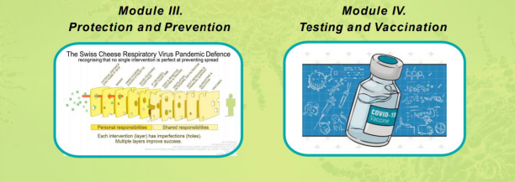
MODULE 4:
Testing, Vaccines, & Variants
ALIKA MAUNAKEA, PHD
BIOMEDICAL EPIGENOMICS
UNIVERSITY OF HAWAIʻI AT MĀNOA
PAULINE W.U. CHINN, EDD
CURRICULUM STUDIES
UNIVERSITY OF HAWAIʻI AT MĀNOA
THE PACIFIC ALLIANCE AGAINST COVID-19
UNIVERSITY OF HAWAIʻI AT MĀNOA
Updated August 23, 2021

Slide 2
Module 4: SARS-CoV-2 Testing, Vaccines, and Variants
Table of Contents
Slide 3 To the Teacher: Standards addressed
Slides 4-7 Virus, infection and symptoms
Slides 8-10 Tests, antibodies, immune response, variants
Slides 11-15 How vaccines work, vaccination patterns
Slides 16-17 Community (herd) immunity, why 70-90%
Learning objectives:
Compare and contrast: SARS-CoV-2 (virus) and COVID-19 (disease).
Explain how PCR and antibody tests work and how they help to keep schools and businesses safe and open.
Explain how infection or vaccines affect our immune system
Explain “herd or community immunity” and why vulnerable populations need to be vaccinated.
Explain how SARS-CoV-2 mutations (variants) can affect infection rates and vaccine effectiveness.
Explain how vaccines are like a layer of cheese in the “Swiss Cheese Model” of protection.
Explore myths about COVID-19, tests, and vaccines.
Conduct informal research with people you know.
Check your learning with a 10 question quiz. You can retake it to score at least 90%
Medical disclaimer: The information in this presentation is not intended or implied to be a substitute for professional medical advice, diagnosis or treatment. All content, including text, graphics, images and information, contained on or available through this presentation is for general information purposes only. We make no representation and assumes no responsibility for the accuracy of information contained on or available through this presentation, and such information is subject to change without notice. You are encouraged to confirm any information obtained from or through this presentation with other sources and review all information regarding any medical condition or treatment with your physician.
Slides 18-21 Variants, Swiss Cheese model
Slides 22-23 Myths and rumors
Slide 24 Research Project, Help for your ‘ohana
Slide 25 10 question quiz, Feedback form
Slide 26-30 References and Appendices

Slide 3
To Teachers: Module 4 addresses NGSS, Health, Common Core, ELA, Nā Hopena Aʻo
Inquiry Standard SS.9-12.1.2 Critique compelling questions that reflect an enduring issue in the field
Next Generation Science Standards: Cross-cutting concepts 2,4, 6
2. Cause and Effect: Mechanism and Prediction: Events have causes, sometimes simple, sometimes multifaceted.
4. Systems and system models: Defining the system under study provides tools for understanding and testing ideas.
6. Structure and Function: The way an object is shaped or structured determines many of its properties and functions
NGSS: MS-LS3 Heredity: Inheritance and Variation of Traits: 1. Develop and use a model to describe why structural changes to genes (mutations) may affect proteins and may result in harmful, beneficial, or neutral effects to the structure and function of the organism.
Common Core CCSS.ELA-LITERACY.RH.11-12.7:
Integrate and evaluate multiple sources of information presented in diverse formats and media (e.g., visually, quantitatively, as well as in words) in order to address a question or solve a problem
Health Education Standards
Comprehending concepts related to health promotion and disease prevention to enhance health.
Analyzing Influences of family, peers, culture, media, technology, and other factors on health behavior.
Nā Hopena A‘o
To develop a sense of Wellbeing | To develop a sense of Belonging | To develop a sense of Aloha | To develop a sense of Community
Nā Honua Mauli Ola:
Promote personal growth and development to strengthen cultural identity, academic knowledge and skills, pono decision making, and the ability to contribute to one’s self, family, local and global communities.
UN Sustainable Development Goal #3 Good Health and Well-being
Ensure healthy lives and promote well-being for all at all ages.

Slide 5
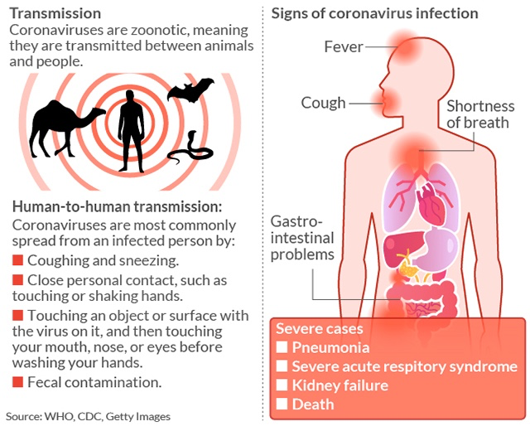
How Does COVID-19 Vary in Severity and Mortality?
5x Pacific Islanders
vs. Hawaiʻi Population
Hawaiʻi Dept. of Health
Research ongoing
Research ongoing
Research on variants
cdc

Slide 6
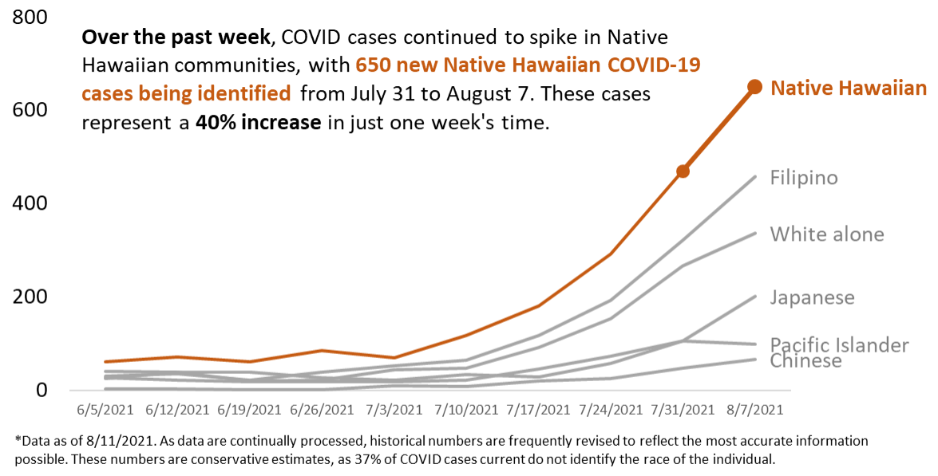
Who is getting sick June - August 2021?

Slide 7
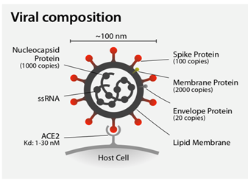
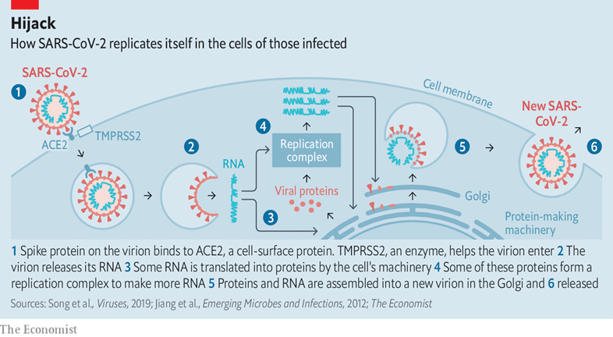
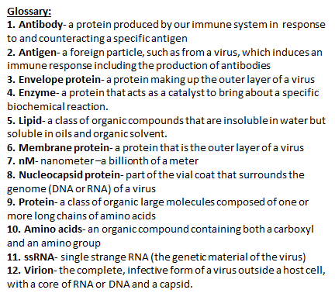
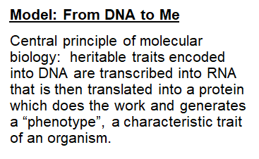

Slide 8
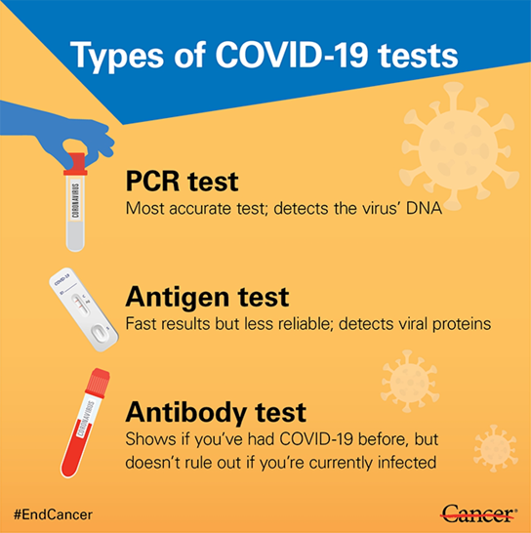
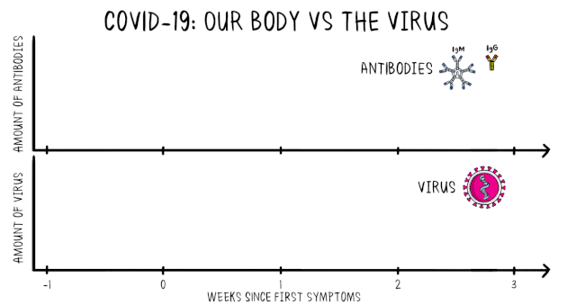
Play Wikimedia clip using link below to see how COVID-19 tests work in relationship to the immune response. COVID-19: Our body VS The Virus
i-2 day nasal swabs
RNA
Fast, color change, nasal swab
15 minutes
Blood
Click on links below to learn more:
PAAC at Kamaile Academy: A model of testing for safer school openings

Slide 9
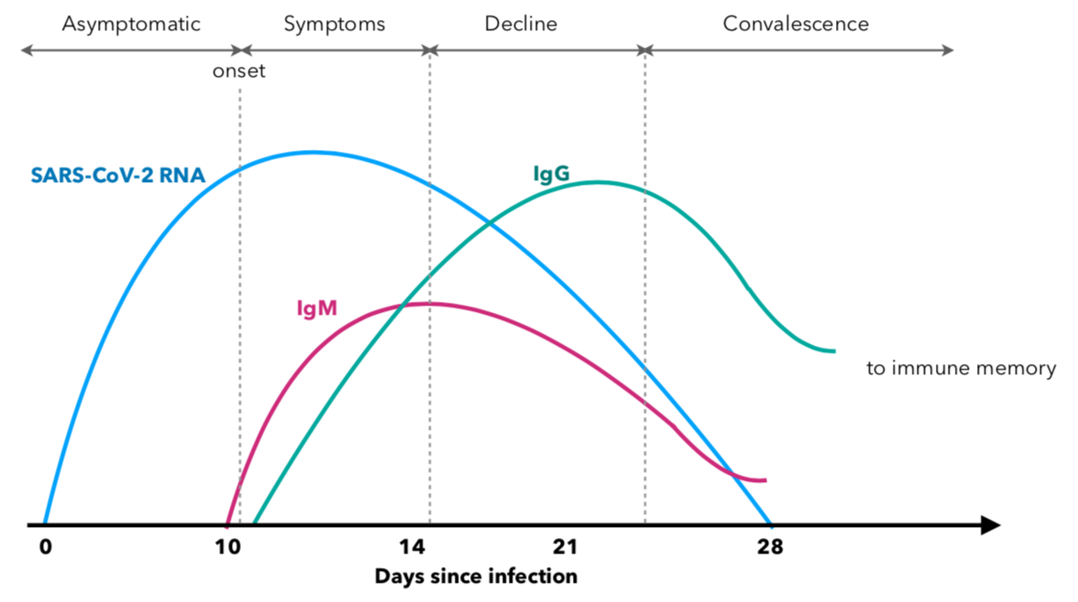
Our immune system responds to viral infection by producing antibodies
Time Series of Immune Response and Testing:
1. Exposure: After first exposure, the SARS-CoV-2 viral load peaks in the nasopharynx (end of nasal passage to back of throat) when symptoms appear (blue line). Viral RNA, the antigen, is detectable by PCR, antigen-based testing.
2. Acute phase: After the first week, the viral RNA (antigen) decreases in the nasopharynx and may no longer be detectable with PCR or antigen-based testing.
3. Antiviral response: produce antibodies: The immune system first produces IgM (red line) then IgG (green line) antibodies against SARS-CoV-2 antigens. Antibody levels decrease during recovery.
4. Antibody tests detect the levels of IgM and IgG the immune system generates to fight the virus.
5. What is PCR? The polymerase chain reaction is a fast, inexpensive technique to "amplify" - copy - small segments of DNA or RNA. It’s “molecular photocopying."
6. What are IgM (Immunoglobulin M) and IgG (Immunoglobulin G) antibodies and what do they reveal about COVID-19 infection?
Most Contagious
Not contagious?
RECOVERY:
Antigen tests show no SARS-CoV-2 by day 28.
Positive test for IgM is evidence of active infection.
Positive test for IgG shows presence of learned defense.
Antibody 2
Antigen Test
Antibody 1
IgG remains as a learned defense
Infection clearing IgG remains as a defender
Recent infection
Immune response
IgM IgG

Slide 10
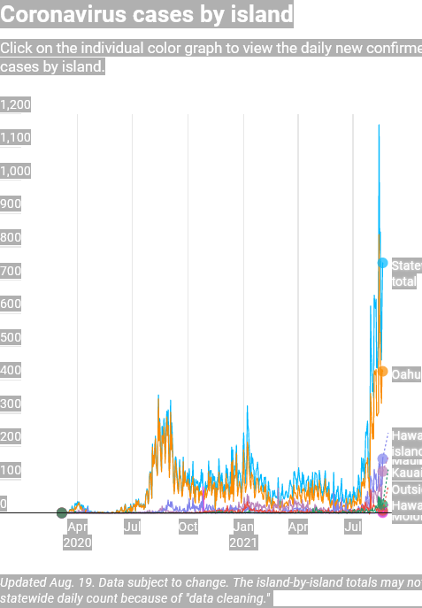
Contagious delta variant responsible for current spike in cases and hospitalizations
Protective antibodies Recovery, 0 virus
Immune malfunction
Virus not cleared
Good: Infections trigger immune responses, recovery, immunity.
Bad: Malfunctioning immune system leads to inflammation, cytokine storm, severe illness, even death.
If you are not vaccinated your body is on its own.

Slide 11
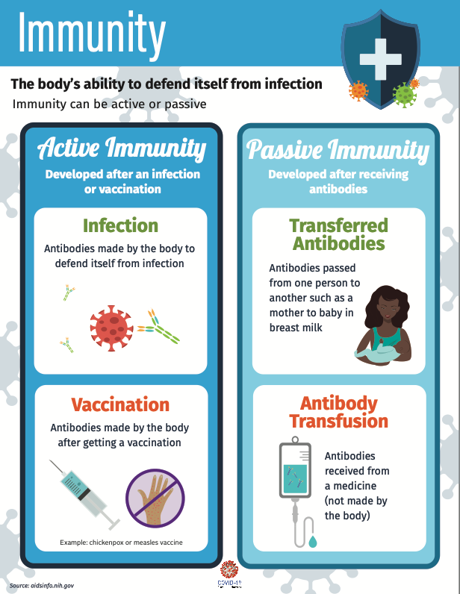
Vaccines teach our body to recognize an invader, such as SARS-CoV-2. This sounds an “alarm,” calling the fighter cells and proteins that are part of our immune system into action. Ultimately this helps the body prevent or control an infection and reduce the severity of disease, and leads to immune memory preventing future infection.
This is called the “Immune Response.”
Vaccines and transferred antibodies prevent infection by SARS-CoV-2 or reduce severity of disease.

Slide 12
How do antibodies protect us? Click on the arrow to play the video.
Why are SARS-CoV-2 vaccines important to me, my school, and my community?
Vaccination and testing keep schools open. Filipinos, Pacific Islanders, and Native Hawaiians are most vulnerable to COVID-19 and suffer the most from school closures. Delta variant leads to worse health and educational inequities.
Resources
What Do Antibody Tests For SARS-CoV-2 Tell Us About Immunity?

Slide 13
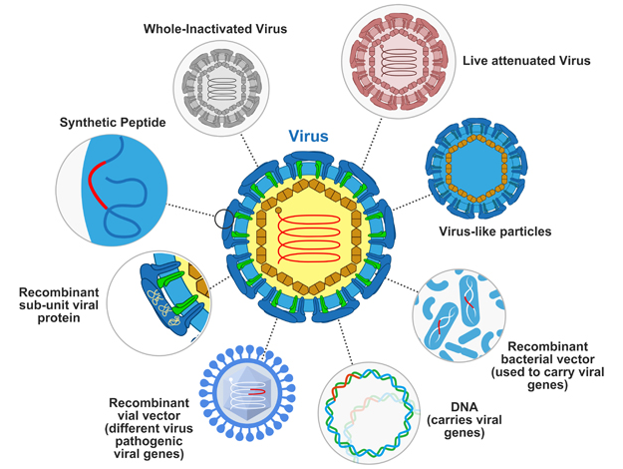
Three vaccines are approved for use in Hawaiʻi Fully vaccinated individuals may get re-infected, but symptoms are generally mild.
Moderna $430 million, uses nanoparticles to deliver mRNA that encodes pieces of SARS-CoV-2 proteins. Your body uses this mRNA to produce subunits of viral proteins that trigger antibodies against it. Two shots, needs to be kept in special freezers at very low temperatures. Approval expected soon.
Pfizer-BioNTech Approved by FDA Aug. 23, 2021, like Moderna uses nanoparticles to deliver mRNA. Two shots, needs to be kept in special freezers at very low temperatures.
Johnson & Johnson $456 million, uses an attenuated, weakened adenovirus carrying a gene that codes for a SARS-CoV-2 surface protein, leading to developing antibodies. One shot, vaccine can be kept at regular freezer temperatures.
Problem: Delta variant is much more infectious. Breakthrough cases occur, but vaccines protect against severe illness. Vaccinating all eligible people, wearing masks, avoiding large gatherings, social distancing, and ventilating will keep ourselves, our ‘ohana and communities safer.
Research (above) continues on new vaccines and on current vaccines’ effectiveness against new variants. Approval of Pfizer and Moderna mRNA vaccines will allow vaccinations to be mandated. Booster shots for vulnerable individuals are likely by fall 2021.
Cohen, Elizabeth, and Dana Vigue. “US Taxpayers Are Funding Six Covid Vaccines. Here's How They Work.” CNN, Cable News Network, 22 June 2020.
Notes:
https://www.genscript.com/recombinant-vaccine.html
https://www.cnn.com/2020/06/22/health/us-coronavirus-vaccine-funding/index.html

Slide 14
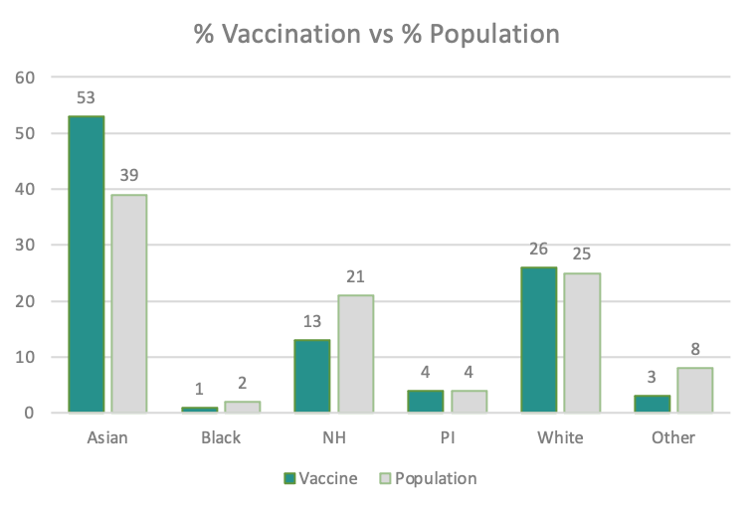
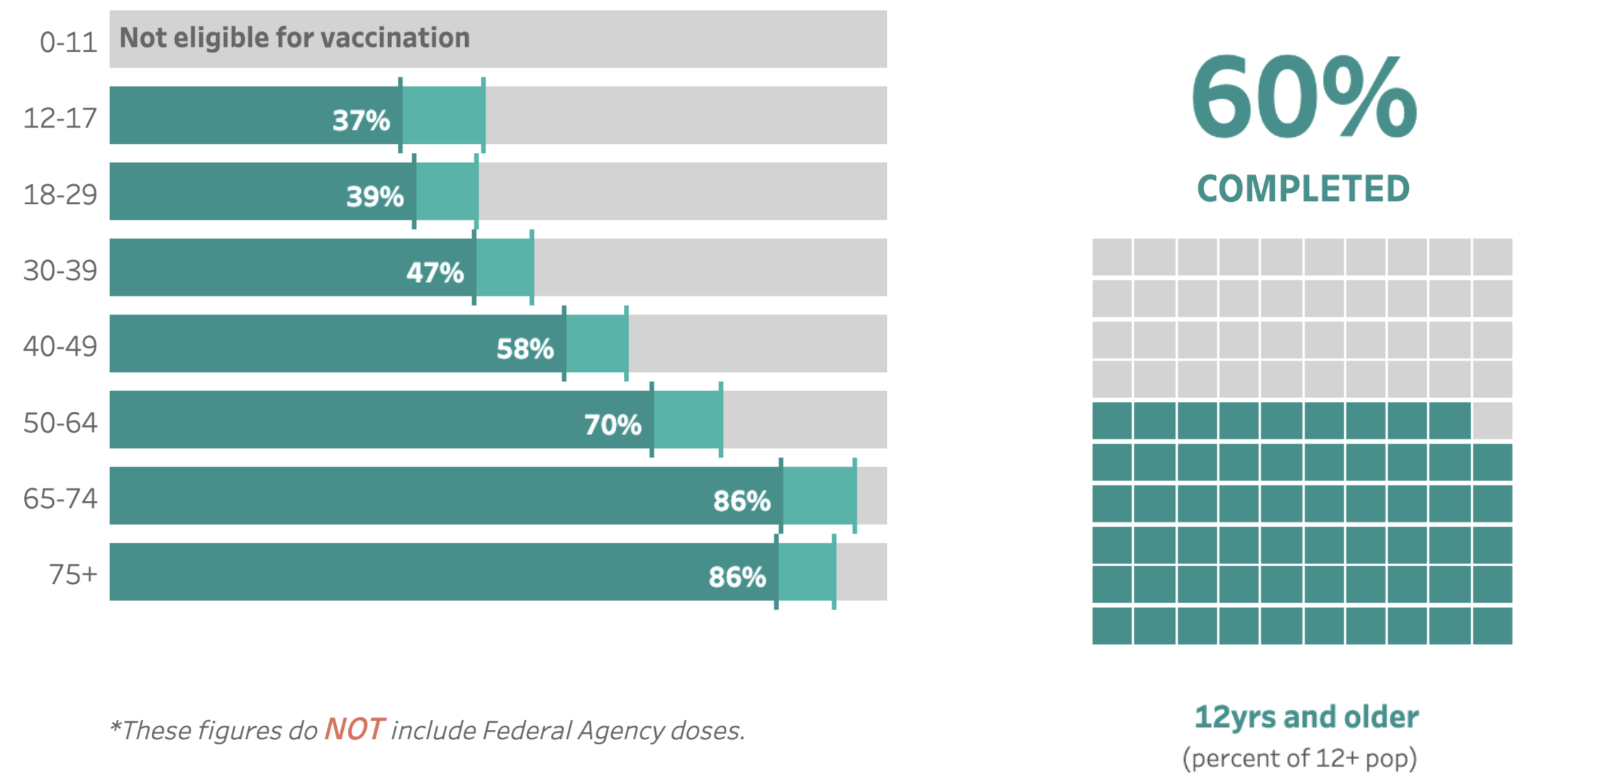
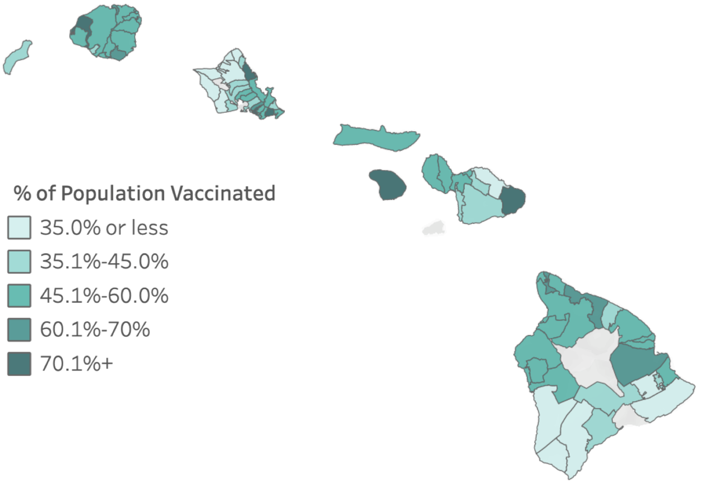
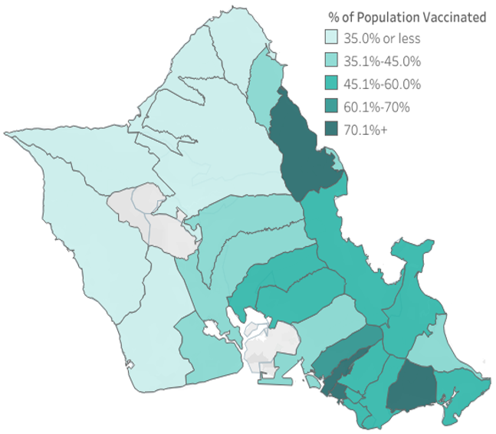
What groups are getting vaccinated by age, ethnicity, place?

Slide 15
Q. Will my vaccination protect me against the new variants?
SARS-CoV-2 keeps mutating. Vaccines already are less effective against variants with mutations in spike proteins targeted by vaccines.
Community spread, NOT travel is the source of most cases.
Q. Can schools open safely?
If several conditions are met:
ALL eligible staff, students, families are vaccinated and mitigation measures are followed.
Schools can request testing.
Design outdoor learning activities.
Ventilate with outdoor air to remove aerosols.
Distance learning options are provided vs one size fits all.
Staff and students make and follow a Covid safety plan (See Module 3).
Should I wear a mask and social distance after I’m vaccinated?
Should I wear a mask and social distance after I’m vaccinated?
How effective are COVID-19 vaccines?
People who are fully vaccinated can be re-infected. The Delta variant is more contagious. Most cases are mild or asymptomatic, but a re-infected person can infect others so more than 70% of people need to be vaccinated to reach community, or herd immunity.
We know COVID-19 vaccines work, but not 100%.
Please wear a mask in indoor and crowded areas to protenerable people and to stop asymptomatic spread.
variants,

Slide 16
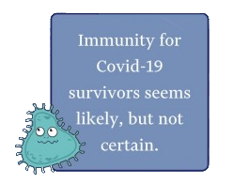
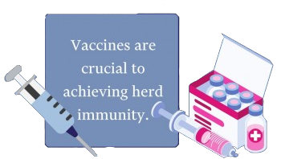
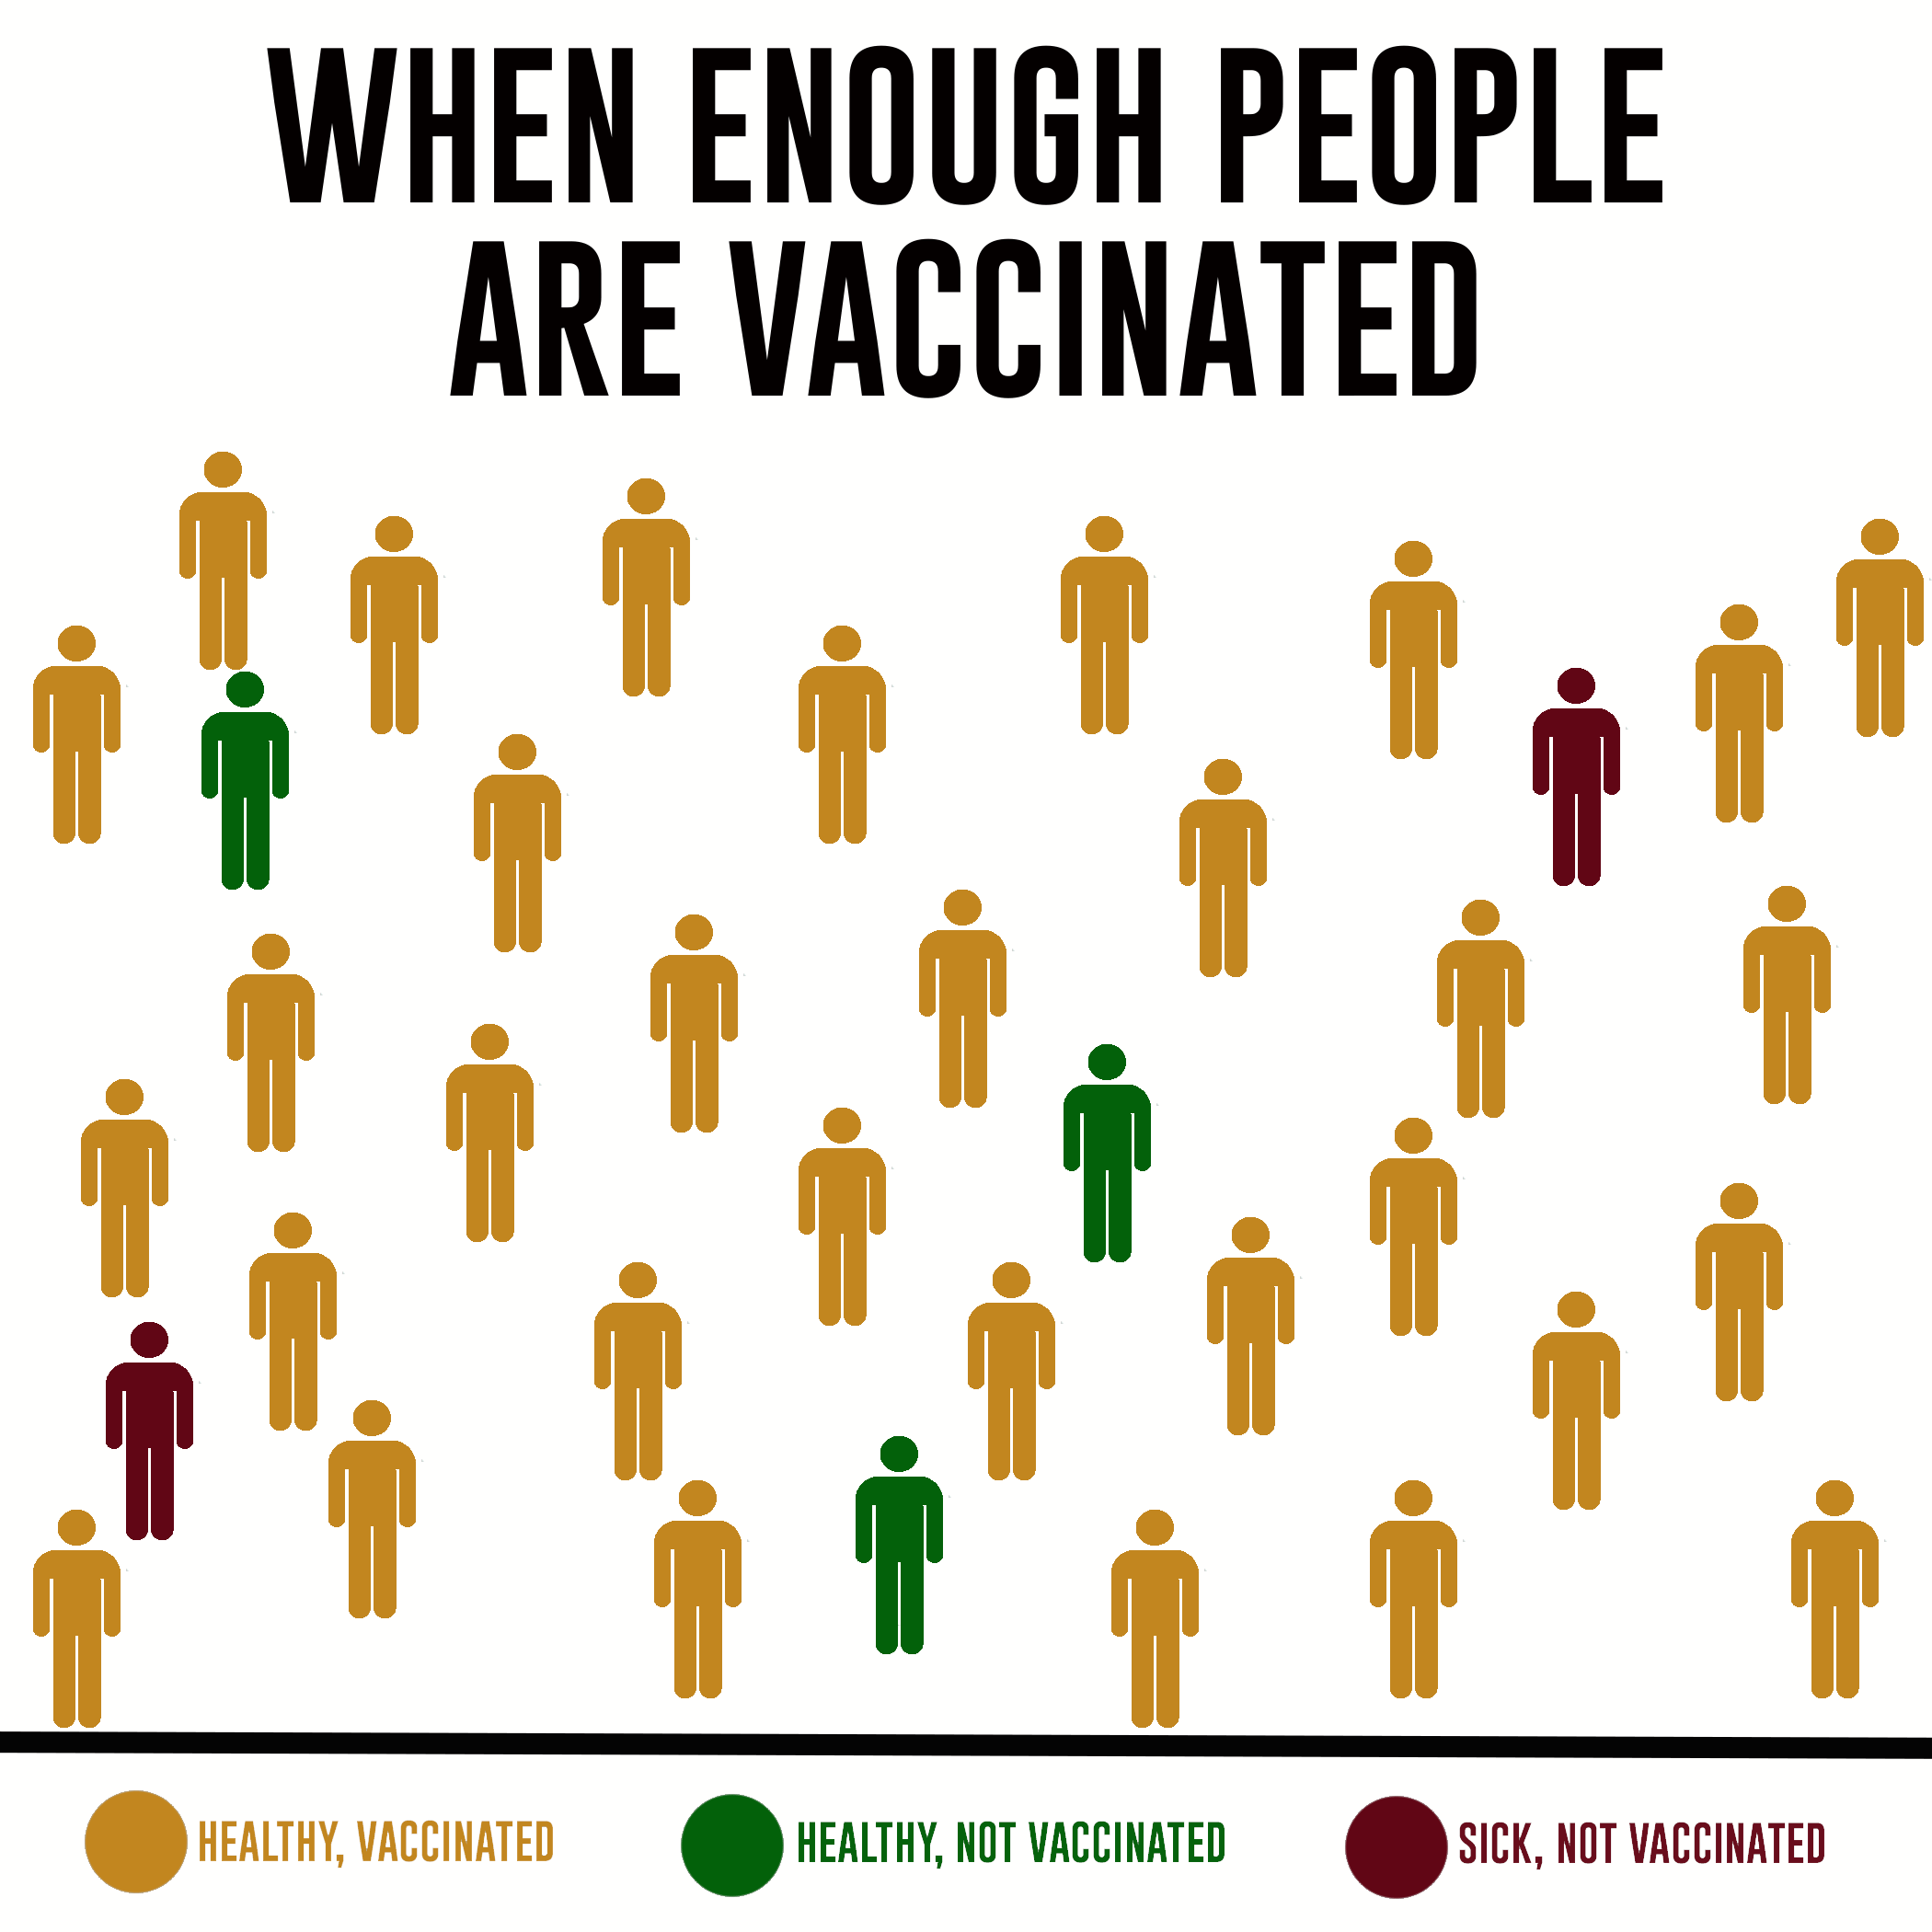
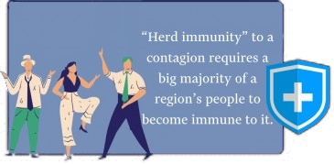
Herd Immunity: Via infection and recovery and/or vaccination
Herd immunity and the COVID-19 pandemic
~70-90% of a population needs immunity to achieve herd immunity, depending on contagiousness of the virus
D'Souza, Gypsyamber, and David Dowdy. “What Is Herd Immunity and How Can We Achieve It With COVID-19?” Johns
Hopkins Bloomberg School of Public Health, Johns Hopkins Bloomberg School of Public Health, 10 Apr. 2020, www.jhsph.edu/covid-19/articles/achieving-herd-immunity-with-covid19.html.
“Herd Immunity: What Is It and Why Does It Matter?” Conway Homer, P.C., Conway Homer, P.C., 22 Nov. 2017,
ccandh.com/herd-immunity-what-is-it-and-why-does-it-matter/.
Labels, No. “Five Facts about Herd Immunity.” RealClearPolicy, RealClear, 21 Apr. 2020,
www.realclearpolicy.com/articles/2020/04/21/five_facts_about_herd_immunity_489585.html.
Notes:
https://ccandh.com/herd-immunity-what-is-it-and-why-does-it-matter/
Johns Hopkins statistics: https://www.jhsph.edu/covid-19/articles/achieving-herd-immunity-with-covid19.html
Herd immunity infographic: https://www.realclearpolicy.com/articles/2020/04/21/five_facts_about_herd_immunity_489585.html

Slide 17
Research shows that COVID-19 vaccines can help us reach community or herd immunity.
#2
#3
#1

Slide 18
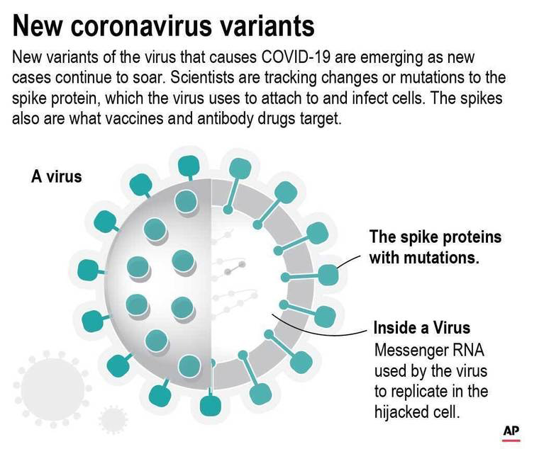
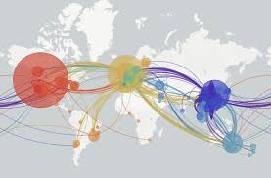
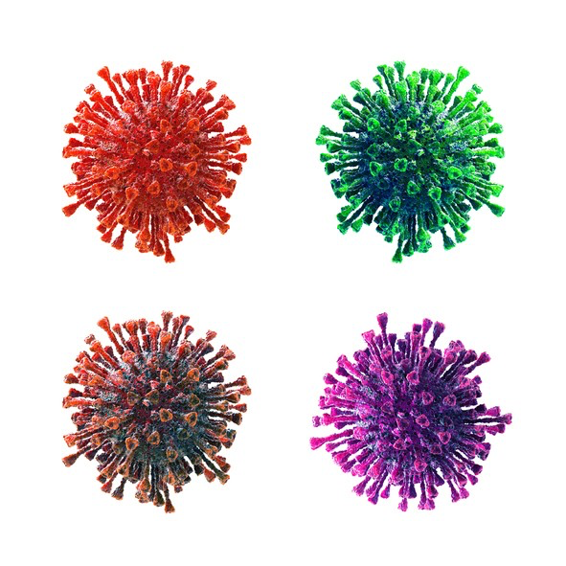
SARS-CoV-2 Variants Are Found in Hawaiʻi
The Race to Vaccinate as SARS-CoV-2 Mutates
We are in a race to vaccinate to stop active COVID-19 ahead of variants.
Variants are expected – all viruses evolve and mutate over time.
SARS-CoV-2 variants result from mutations in the genome (mRNA) of the virus.
Vaccines made from the mRNA of the original spike proteins may become less effective against variants.
Both infection rates and deaths are highest among unvaccinated people.
The highly transmissible delta variant is in Hawai‘i
Variants travel worldwide with global travel.
FDA approved Pfizer vaccine Aug. 23, 2021, Moderna approval expected soon.
Booster shot expected for vulnerable populations soon.
Delta variant is responsible for majority of new cases in the US.
We have vaccines but people are still dying from COVID-19. Why?

Slide 19
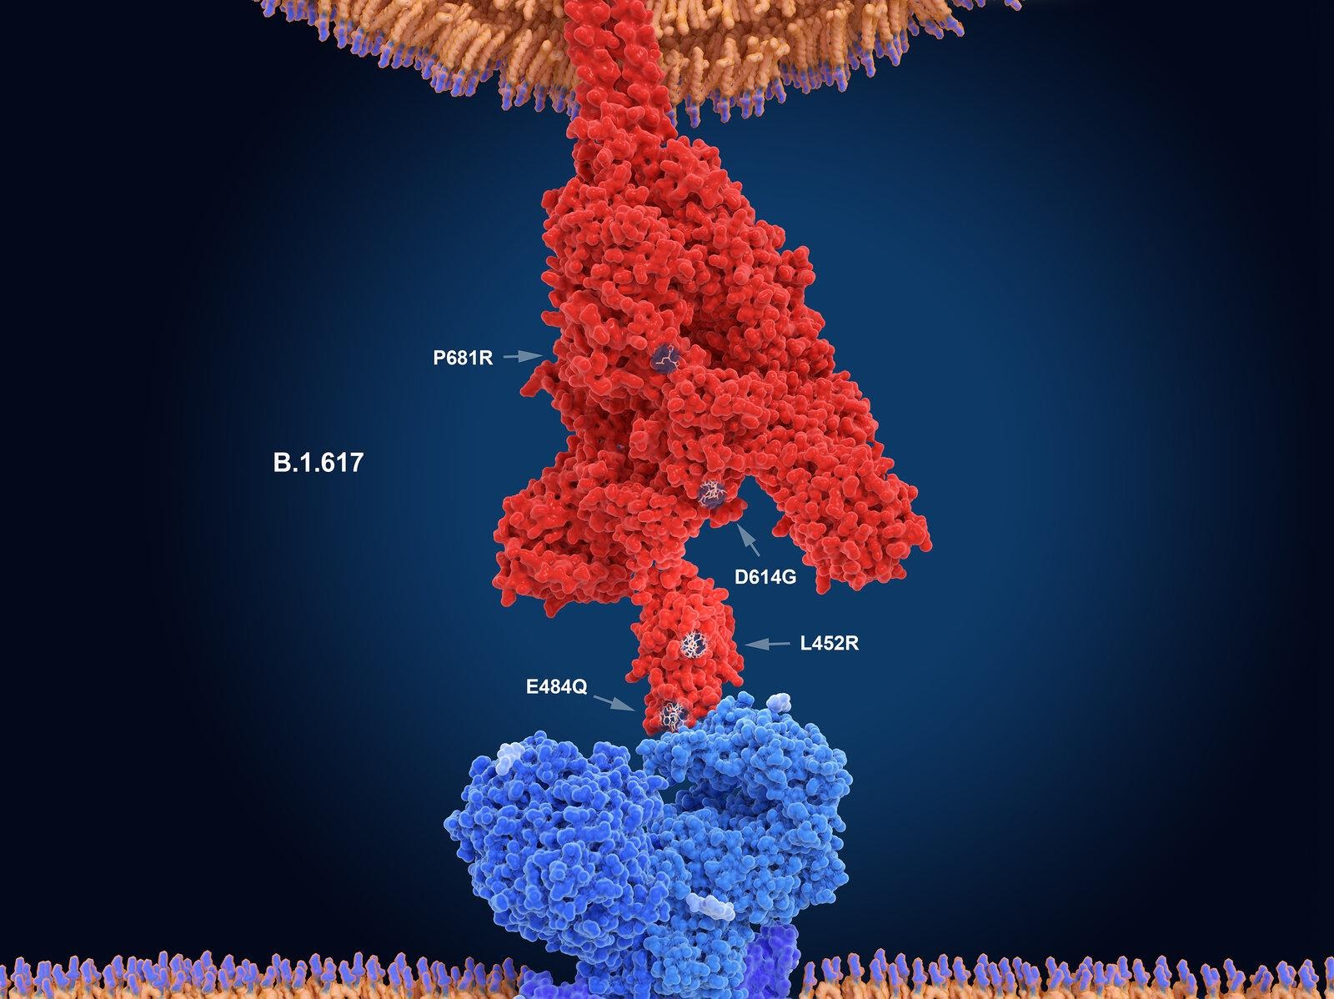
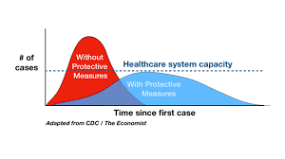
Delta Variant Causing Spikes in Cases
DELTA VARIANT COMPARED TO ORIGINAL STRAIN
Responsible for > 80% of COVID-19 cases
Spreads 2-3 times faster
~1,000 times more copies of the virus in respiratory tracts
Infectious sooner: 4 days for delta variant to reach detectable levels VS. 6 days.
Does not increase risk of hospitalizations in vaccinated people
Most cases are unvaccinated individuals
Queen’s & Straub at capacity
Li et al, Viral infection and transmission in a large well-traced outbreak caused by the Delta SARS-CoV-2 variant, July 2021 Genetic Epidemiology

Slide 20
If you are vaccinated you are:
Less Likely to get Covid
Less symptomatic and less likely to spread Covid
Less “sick”
Less likely to be hospitalized
Protects against Delta variant.
If you are NOT vaccinated you are:
Much more likely to get Covid
Much more symptomatic
Much more likely to spread Covid
More “sick”
More likely to be hospitalized
No protection against Delta variant.

Slide 21
The variant vs. vaccine race:
A new layer of protection in the “Swiss Cheese” Model of COVID-19 Defense
Read: Minnesota Reports 89 COVID-19 Cases in Vaccinated People
Vaccines have new “holes” when variants affect the spike protein that antibodies target. If the fit is not right antibodies won’t attach.
As long as we have asymptomatic and active cases in our community, SARS-CoV-2 will continue mutating into variants that may be more infectious &/or deadly like more mice eating holes in the cheese.
Due to Delta variant even after being vaccinated we still need to wear masks, socially distance, ventilate, and sanitize.

Slide 22
Myths and Rumors: Tests and vaccines CANNOT cause SARS-CoV-2 infection or cause COVID-19 illness.
If your friends or family don’t want to get tested or vaccinated because they worry about getting infected with the virus causing COVID-19, you could tell them this story.
If you see a wheel with spokes, handlebars, and a chain you will probably think of a bicycle. But you cannot ride it—it’s not a working bicycle.
In the same way, the few pieces in a vaccine are not a working virus and cannot cause infection or COVID-19.
CURIOUS?
Explore the References and appendices to go deeper into how Moderna and Pfizer-BioNTech’s mRNA vaccines work in the slides following References.

Slide 23
Have you heard these common myths and rumors?
Have you heard these common myths and rumors?
Start with Myth: Vaccines can cause Autism
Then explore your questions at VIDEOS by COVID-19 PREVENTION NETWORK
Congratulations!
After viewing a few videos, you are ready to review then take a 10 question quiz to check your learning. You can take the quiz multiple times to reach a goal of 90%.

Slide 24
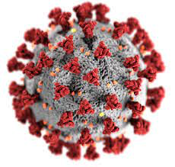
Research: Click on Tests, Vaccines, and Variants for Report Sheet
How many people do you personally know who had COVID-19? What impacts did it have on their lives?
How many people do you know who DO NOT want to get tested or vaccinated?
Why do you think they feel this way?
How many people do you know who ARE or WANT to be vaccinated?
Why do you think they want to get vaccinated?
Ask someone who got vaccinated if s/he still worries about getting COVID-19 and why.
If worried, what does s/he do to prevent infection?
Reflection: what are your thoughts about getting vaccinated?
Reflection: Considering what you learned about tests, vaccines, and variants what would you say to someone who hesitates to get tested or vaccinated?
If you were in charge of tests and vaccines in Hawai‘i, what would you do?
INFORMATION & HELP FOR YOUR ʻOHANA
If you need to get tested or know someone who needs to get tested, please consider the drive-thru at the Wai‘anae Coast Comprehensive Health Center.
For screenings and appointments please call the WCCHC Hotline:
808-697-3170
RESOURCES
www.paac.info
https://www.coronaviruspreventionnetwork.org

Slide 25
Testing, Vaccinations, and Variants 10 Question Quiz & Feedback Form
First review the slides and diagrams and click on links to read articles and view videos.
Second, review Glossary
Third, click on “10 Question” link to start the quiz for this module.
Your goal is to score at least 90%, 9 correct out of 10.
If under 90%, do not submit. Your can review and retake the quiz twice more.
Some questions may be different in each quiz.
Finally, please click on the link for a very short Feedback Form that lets us know your thoughts about this module and how we can follow up to make it better.
Mahalo nui loa, thank you very much for your time!!!
Want to learn more? Visit PAAC project website paac.info, explore the References, and go deeper into types of tests and how mRNA vaccines work in the final slides.

Slide 26
Additional References
Bureau of Labor Statistics. The Employment Situation March 2020. Washington DC: Bureau of Labor Statistics; 2020
Centers for Disease Control and Prevention (CDC). Severe Outcomes Among Patients with Coronavirus Disease 2019 (COVID-19) — United States, February 12–March 16, 2020. MMWR 69(12); 343-346.2020. Accessed July 3, 2020 at https://www.cdc.gov/mmwr/volumes/69/wr/mm6912e2.htm
CDC. COVID-19 in Racial and Ethnic Minority Groups. https://www.cdc.gov/coronavirus/2019-ncov/need-extra-precautions/racial-ethnic-minorities.html
Kochhar R, Cilluffo A. How wealth inequality has changed in the U.S. since the Great Recession by race, ethnicity and income. Pew Research Center. 2017 Accessed June 29, 2020 at https://www.pewresearch.org/fact-tank/2017/11/01/how-wealth inequality-has-changed-in-the-u-s-since-the-great-recession-by-race-ethnicity-and-income/.
Millet GA, Jones AT, Benkeser D, Baral S, Mercer L, Beyrer C, Honermann B, Lankiewicz E, Mena L, Crowly JS. Sherwood J, Sullivan P. Assessing Differential Impacts of COVID-10 on Black Communities. Annals of Epidemiology. 2020
Oppel RA, Gebeloff R, Lai KKR, Wright W, Smith M. The Fullest Look Yet at the Racial Inequity of Coronavirus. New York Times. July 5, 2020. Accessed July 6, 2020 at https://www.nytimes.com/interactive/2020/07/05/us/coronavirus-latinos-african-americans-cdc-data.html
Perry AM, Harshbarger D, Romer C, 2020. Mapping Racial inequity amid COVID-19 underscores policy discriminations against Black Americans. Brookings. 2020. Accessed July 1, 2020 at https://www.brookings.edu/blog/the-avenue/2020/04/16/mapping-racial-inequity-amid-the-spread-of-covid-19/
Poteat T, Millet GA, Nelson LE, Beyrer C. Understanding COVID-19 risks and vulnerabilities among black communities in America: the lethal force of syndemics. Annals of Epidemiology 47:1-3. 2020
Stephenson K, Ojikutu B. COVID-19 vaccine research must involve Black and Latinx participants. Here are 4 ways to make that happen. Accessed July 6, 2020 at https://www.statnews.com/2020/06/26/covid-19-vaccine-trials-must-include-black-and-latinx-participants/
van Dorn A, Cooney R, Sabin ML. COVID-19 exacerbating inequalities in the US. Lancet 39. 2020 accessed July 1, 2020 at https://www.thelancet.com/action/showPdf?pii=S0140-6736%2820%2930893-X
Villarosa L. “A Terrible Price: The Deadly Racial Disparities of COVID-10 in America. https://www.nytimes.com/2020/04/29/magazine/racial-disparities-covid-19.html
Yancy CW. COVID-19 and African Americans. JAMA. 323(19):1891-1892. 2020

Slide 27
The Three Major Types of COVID-19 Tests: Q & A
Topic | Type of Test
What type of test is it? | Molecular PCR) | Antigen for SARS-CoV-2 | Serology (or Antibodies in Blood)
What kind of samples can be used? | Nasal or throat swab or saliva sample | Nasal or throat swab sample | Blood sample
What does it detect/measure? | The viral RNA | A viral particle such as the Spike protein | The antibodies your body makes against SARS-CoV-2
What does a positive result mean? | Active infection | Active infection | Past infection
What does a negative result mean? | Not infected at the time the sample was collected. | SARS-CoV-2 viral proteins were not detected. However, a negative test does not rule out infection. | No COVID-19 in the past. However, person could still have a current infection, and the test was collected too soon to give a positive result.
When is this test helpful? | It can be used to determine who has an active infection. | It can be used to quickly determine who has an active infection. | It can identify people who had an infection in the past, even if they had no symptoms of the illness.
 | It can help identify people who are contagious to others. | It can help identify people who are contagious to others. | In some cases, it could help determine when COVID-19 illness occurred, since we know that IgM is formed before IgG and that IgM goes away before IgG.
 |  | It is a less expensive and faster test than a molecular test. | It can help determine who qualifies to donate convalescent plasma (a blood product that contains antibodies against SARS-CoV-2 to treat COVID-19).
 |  |  | If lots of people take the test in a community, it can help public health leaders and researchers know what percentage of the population has already had COVID-19.

Slide 28
SARS-CoV-2 Virus
Spike protein
Muscle cell
Watch companion video from Johns Hopkins: https://www.youtube.com/watch?v=w4sUuFBEo2g

Slide 29
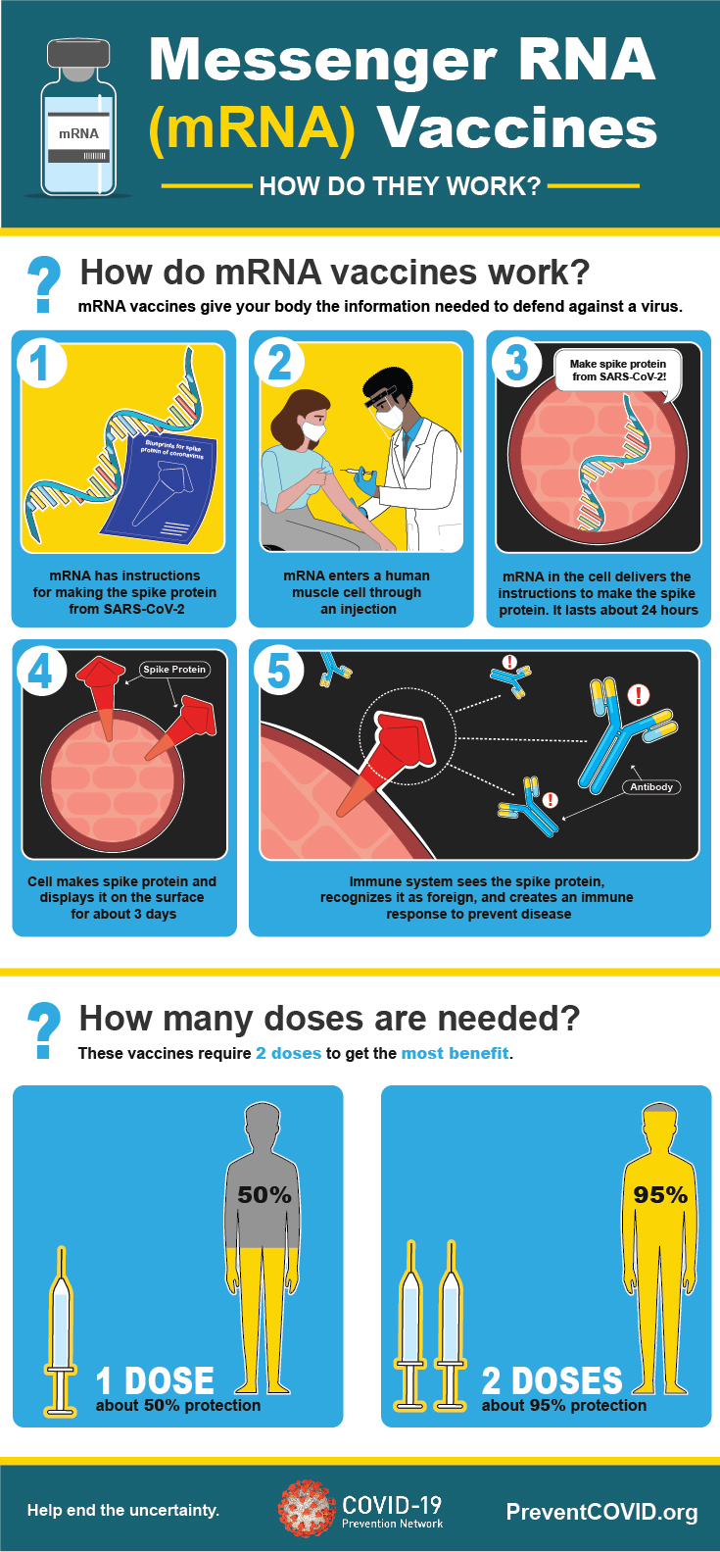
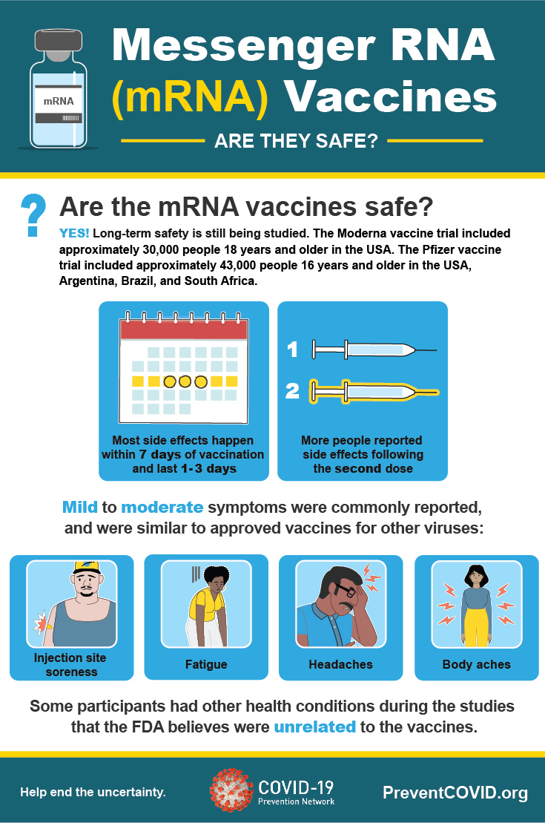

Slide 30
