Slide 1
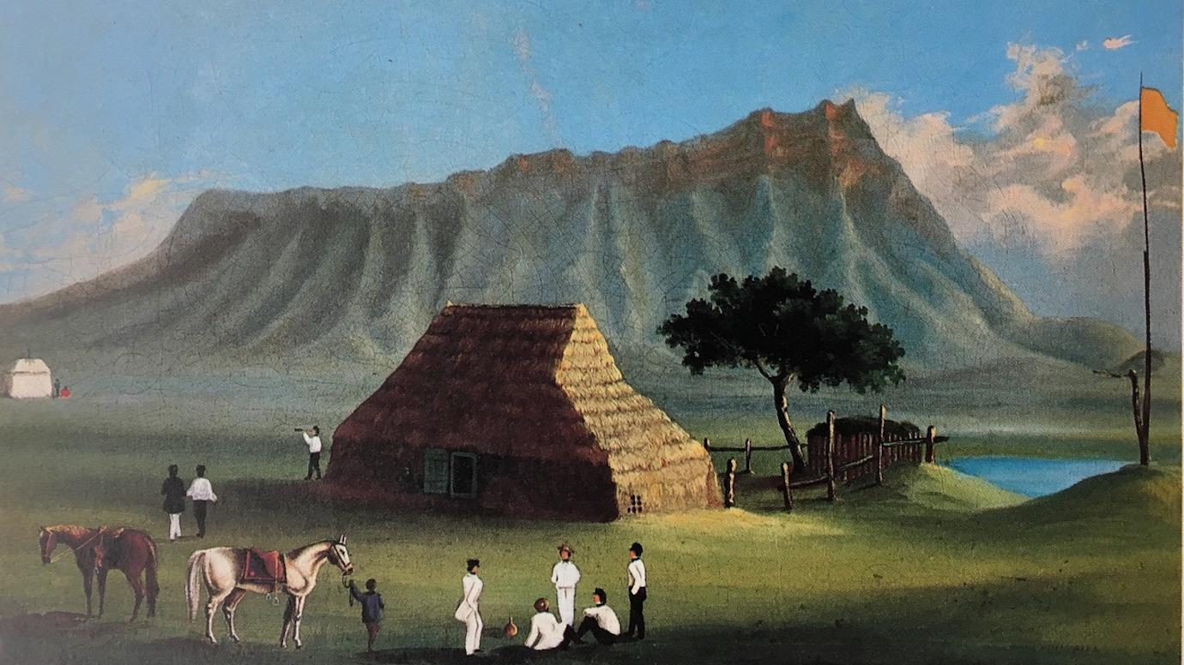
MODULE I COVID-19 CURRICULUM
History of Infectious Diseases in Hawaiʻi and the Pacific:
Caring for People Past, Present, and Future
View of Smallpox Hospital, c. 1853-59 (Wikipedia Commons)
Riley Kauʻilani Wells, Kyle Kolomona Nakatsuka, Pauline W. U. Chinn
University of Hawaiʻi at Mānoa
Pacific Alliance Against COVID-19 (PAAC)
NSF Teacher Leadership Project

Slide 2
Why Study the Pacific’s History of Introduced Infectious Diseases?
TO ADDRESS THE ESSENTIAL QUESTION:
What can we learn from the experiences, values, and actions of Hawaiians and Pacific Island peoples to guide us in the current COVID-19 pandemic?
In this module you will:
Study the impacts of introduced diseases in the Pacific up to 2019 measles outbreak and COVID-19 pandemic.
Learn terms and concepts related to Hawaiʻi’s past and present public health practices.
Learn why 90% of the Hawaiian population died from introduced infectious diseases between 1788-1900.
Study Princess Liliʻuokalaniʻs 1891 quarantine of Oʻahu to stop a smallpox epidemic.
See how 6 Tongan teenagers survived on a kapu island through cultural values, knowledge, and practices.
Consider how Polynesian values and actions apply to the COVID-19 pandemic.
Take a 10-question quiz to check your learning. You may retake it for a higher score.

Slide 3
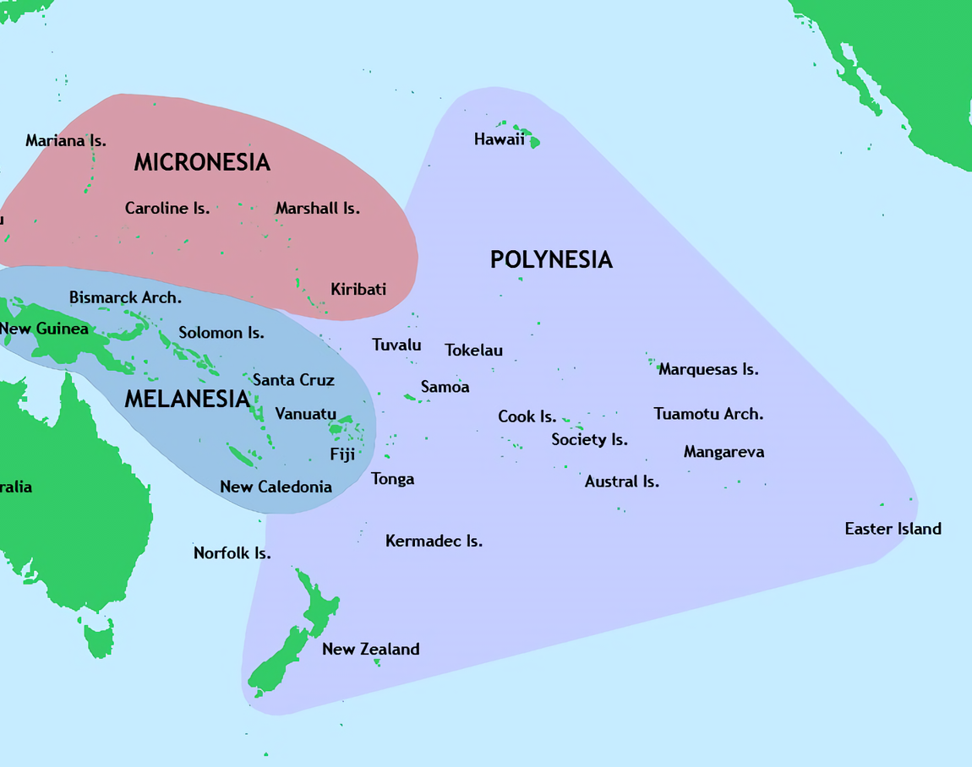
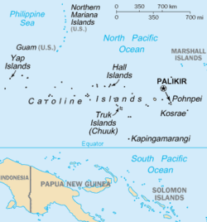
Deadly Foreign Diseases in the Pacific
Infectious foreign diseases both devasted and destabilized isolated Pacific Island nations. First exposure often killed 20-70% of the population.
In 1854 the whaleship Delta stopped at Pohnpei to drop off two crew with smallpox and bury a third. Contact with the men and clothes spread smallpox, killing 4,000, 40 percent of its people.
In 1856 smallpox reached Guam, killing 4,000, 40% of its people.
In 1859 the first traders brought influenza to the Marshall Islands. Missionaries wrote about bodies wrapped in mats with small sails attached being released at sea. Epidemics of measles and influenza in 1861 and typhoid fever in 1863 killed many more.
A fifth of Samoans died in the 1918 Spanish flu pandemic. None died in American Samoa due to a strict quarantine.
In 2019, 85 Samoans died from measles as 31% were vaccinated. An antivaccination activist was arrested for “incitement against a government order.” In American Samoa no one died as almost everyone was vaccinated.
https://en.wikipedia.org/wiki/Caroline_Islands
Vaka Moana: Voyages of the Ancestors-the discovery and settlement of the Pacific, Ed K.R. Howe, 2008, https://commons.wikimedia.org/w/index.php?curid=61904861

Slide 4
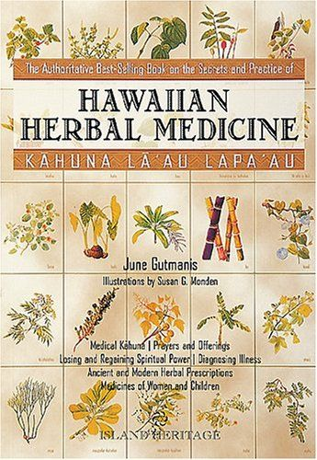
Lawe li'ili'i ka make a ka Hawai'i, lawe nui ka make a ka haole. Death by Hawaiians takes a few at a time; death by foreigners takes many. (No.1960, Pukui)
Overall, Hawaiians enjoyed good health before western contact. People were active, food was organic and mostly plant-based, strict rules kept water clean, isolation kept out diseases (Abbott, 1992).
Well-trained kahuna laʻau lapaʻau, herbal doctors, prepared 12 commonly used medicinal plants, 8 brought by Polynesian voyagers.
Diagnosticians, kahuna hāhā, memorized the characteristics and history of diseases from the place and time of first appearance to the present. We use this process, contact tracing, to identify persons who may have been in contact with someone infected with COVID-19.
Foreign ships brought new diseases: smallpox, measles, flu. With no prior exposure and no immunity, many people died. These observations led to a new ʻōlelo noʻeau, “Lawe li'ili'i ka make a ka Hawai'i, lawe nui ka make a ka haole. Death by Hawaiians (diseases) takes a few at a time; death by foreigners (diseases) takes many.”

Slide 5
Hawaiʻi’s historical relationship with introduced disease
Centuries of isolation left Native Hawaiians with no immunity to introduced diseases.
Laʻau lapaʻau, traditional herbal medicine, worked for familiar illnesses but was ineffective against introduced diseases.
Learn more about cholera, measles, smallpox, leprosy, Spanish flu, whooping cough, bubonic plague, scarlet fever.
Whooping cough epidemic
Kunu kalea kills thousands.
Bubonic plague
61 deaths.
Chinatown destroyed.
Spanish Flu 1918-20 kills 2,300
Hawaiian Medicine Board
Licensure for Lāʻau Lapaʻau practitioners.
Maʻi okuʻu (cholera)
Kills 15,000
California Gold Miners
Diarrhea, flu, measles kill >10,000.
Father Damien
Serves leprosy patients at Kalawao.
Moikeha
Hawai‘i relatively free of disease.
Smallpox epidemic
Maʻi puʻuliʻiliʻi kills 7,000.
Hawaiian Medicine Board is abolished
Lāʻau Lapaʻau no longer licensed.
1778
1819
1840
1850
1870
1882
1911
1959
1400
1804
1832
1845
1853
1874
1899
1919
1965
2019
COVID-19
Hawaii is proclaimed a state by U.S. congress
Kamehameha suffers stroke
Kapu system overthrown.
First Board
of Health
Appointed by Kamehameha III.
4th smallpox epidemic
From China; kills 282.
Yellow fever
Fumigation and sanitation to control mosquitoes.
Captain Cooke
Gonorrhea (maʻi hilo, paia), syphilis (kaokao), tuberculosis (akepau)
First case of leprosy
Maʻi Pākē; Maui.
Scarlet Fever epidemic
Piwa ʻulaʻula; Maui.
“Hawaiian Health Timeline and Events.” Kekuni Blaisdell, 1998. Updated by Papa Ola Lokahi, 2016, Chinn 2020
.

Slide 6
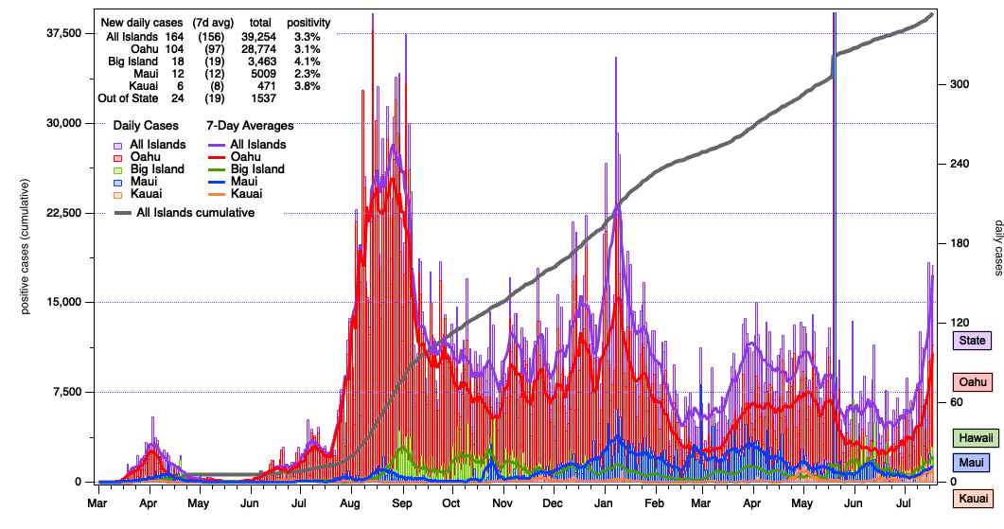
COVID-19 Cases March 20, 2020 - July 2021
Graphs show policies, human behavior, vaccinations, and virus causing COVID-19 interact in complex ways.
--- All islands cumulative cases

Slide 7
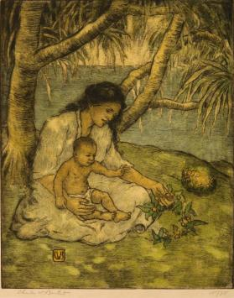
Minamina ‘ia ka ‘ike Hawai’i | Hawaiian language, health, leadership
mina.mina
1. nvt. To regret, be sorry, deplore; to grieve for something that is lost; regret, sorrow.
ʻAʻole minamina ʻo lākou i ke ola. They do not set much value on human life.
2. To prize greatly, value
greatly, especially of
something in danger of
being lost; to value, place
great value on.
He mea minamina ʻia ke
keiki. A child is to be prized.
Source: Ulukau: Nā Puke Wehewehe
ʻŌlelo Hawaiʻi
Hawaiian Mother and Child,
ca. 1920. C. W. Bartlett
(Honolulu Museum of Art)
We expect our leaders to make decisions based on best information to care for the people and the land, but it is our kuleana, responsibility, too.
Read “Shutting Down Hawai‘i: A Historical Perspective on Epidemics in the Islands” here.
Read Hawaiian language newspaper articles on epidemics here.
Read American Samoa repatriation program detects 5 coronavirus cases on Oahu
We all must take informed actions to avoid COVID-19 regrets, minamina.
Community spread, not travel, causes most COVID-19 cases in Hawaiʻi.
Updated daily: COVID-19 Dashboard with race, age, gender, county, source of contagion.
Current information: What You Should Know, Get the facts on COVID-19.

Slide 8



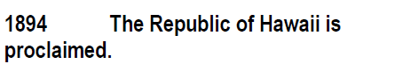
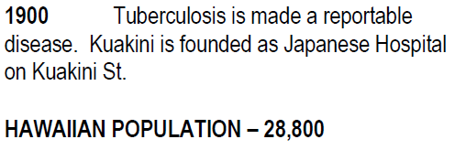

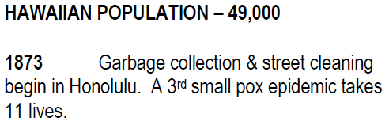
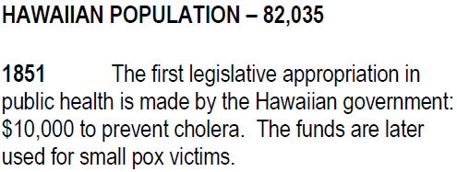


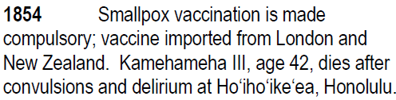
The Kingdom prioritized public health by monitoring (kilo) and acting to prevent disease.
The Kingdom passed a Quarantine Law in 1839, the US followed in 1878.
Hawaiian Population | 49,000
Hawaiian Population | 28,800
Hawaiian Population | 82,035
Queen Liliʻuokalani yields under protest.
40,000
Mina.mina
2. To prize greatly, value greatly, especially of something in danger of being lost; to value, place great value on.
The Aliʻi founded: Queen’s Hospital, Kapiʻolani Hospital, Lunalilo Home, Queen Liliʻuokalani Trust.
Hawaiian Population | 40,000
Foreign Population | 50,000
“Hawaiian Health Timeline and Events.”
Dr. Kekuni Blaisdell, 1998. Updated by Papa Ola Lokahi, 2016
Notes:
Reflection | Knowing Hawaii’s tragic history and relationship with disease:
The number of deaths gets smaller and smaller with each passing epidemic
Thas a resilience if i ever saw one
this doesnʻt even scratch the surface of Hawaiʻis relationship with Smallpox; let alone with all the other epidemics that happened

Slide 9
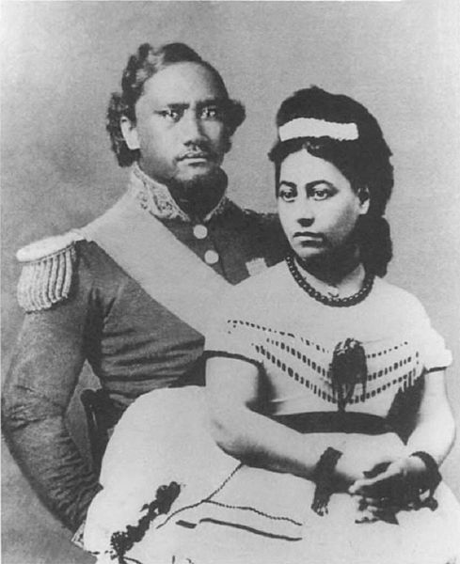
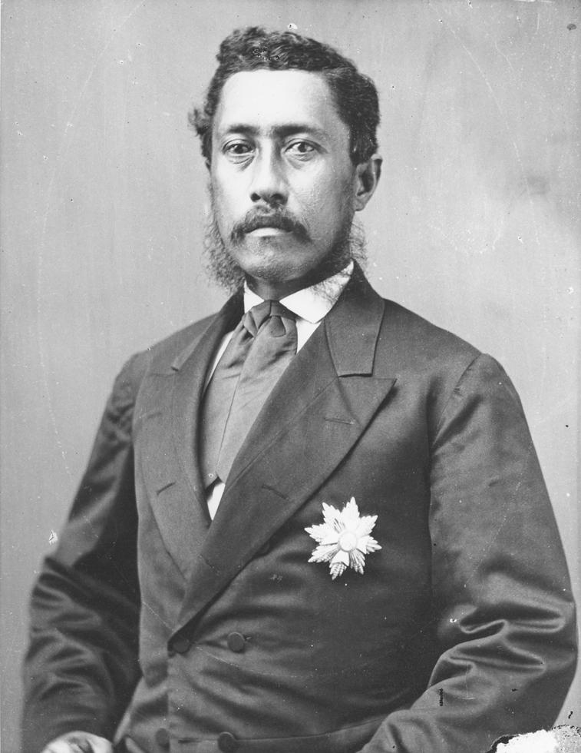
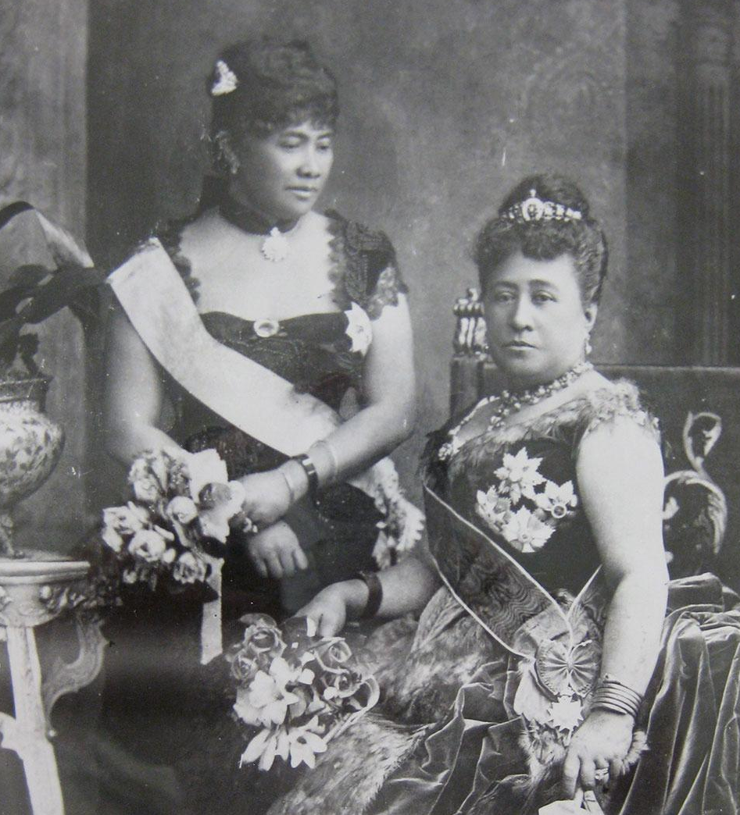
Visionary Leadership: Actions of Aliʻi to care for keiki to kūpuna into the future
Queen’s Hospital was founded in 1859 by Queen Emma and King Kamehameha IV to address the diseases that were decimating the Hawaiian population. There was no money in the treasury, so they personally solicited funds and donated their own money to raise $13,530 to build the hospital.
Lunalilo Home was established by the will of William Charles Lunalilo, who died a bachelor in 1874. King Lunalilo was the first large landholding aliʻi to create a charitable trust for the benefit of his people. The trust built a home for the poor, destitute, and infirm people of Hawaiian blood, with preference given to older people.
Wikimedia Commons
Wikimedia Commons
Lydia Lili‘u Loloku Wewehi Kamaka‘eha, sister of King Kalākaua and hanai sister of Princess Pauahi, was a scholar, principled and knowledgeable leader, musician, and composer. When 10, young Lili‘u witnessed grief and suffering during the 1848 measles epidemic that killed over 10,000. She established the Queen Lili‘uokalani Trust in 1909 with ancestral lands from her mother, Keohokālole. The Trust is dedicated to the wellbeing of the least fortunate Hawaiian keiki. Orphans and destitute Hawaiian children are the primary beneficiaries of her estate.
Concerned about the welfare of mothers and babies, Queen Kapiʻolani, Consort to King Kalākaua founded the Kapiʻolani Maternity Home in 1890 with $8,000 raised by holding bazaars, luau and other benefits. In 1909, Albert and Emma Kauikeolani Wilcox donated funds for Kauikeolani Children’s Hospital as two out of seven babies died in their first year. In 1978, Kapiʻolani and Kauikeolani Children’s Hospitals became Kapiʻolani Medical Center for Women & Children.
Queen Kapiʻolani (R), Crown Princess Liliʻuokalani (L) at 1874 Golden Jubilee. (Liliʻuokanlani Trust)

Slide 10
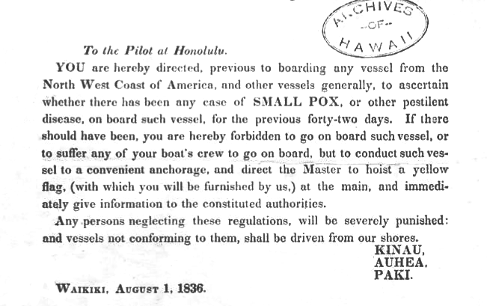
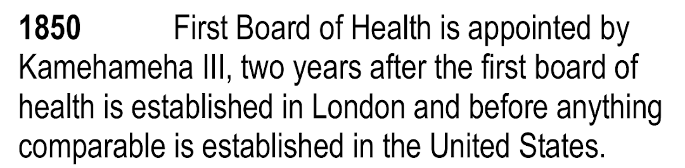
Public health during the Kingdom: Hoʻomalu i ka wa mā mua, a hoʻomalu nō i ka wā ma hope; Protect the past and protect the future
Credits: Hawaii Judiciary Archives / Punawaiola
“Hawaiian Health Timeline and Events.”Dr. Kekuni Blaisdell, 1998. Updated by Papa Ola Lokahi, 2016.
Notes:
Look up “Quarantine law” and “vital statistics act”
1822
First water filtration plant on Oahu is established (Hope & Hope, 2003).
1850
First cases of cholera epidemic diagnosed in San Francisco were Kanakas ​(Hope & Hope, 2003)
1862
In order to address sanitation issues and address the depopulation of Native Hawaiians, the Sanitary Commission was created. (Hope & Hope, 2003).
1895
Cholera epidemic hits the islands, killing 64. Originating from China and Japan and arriving aboard the “Belgic,” the disease is confined to Honolulu (Mills & Ryder, 1896)
1898
The Food Commissioner Department is initiated to handle sanitation issues in the food industry (Hope & Hope, 2003).
1911
Another cholera outbreak in Hawaii. Out of 27 cases, 21 were fatal. (Hope & Hope, 2003) // 1911 Prohibition of Poi (Kim, n.d.)
Reflection | Knowing Hawaii’s tragic history and relationship with disease:
The number of deaths gets smaller and smaller with each passing epidemic
Thas a resilience if i ever saw one
this doesnʻt even scratch the surface of Hawaiʻis relationship with Smallpox; let alone with all the other epidemics that happened

Slide 11
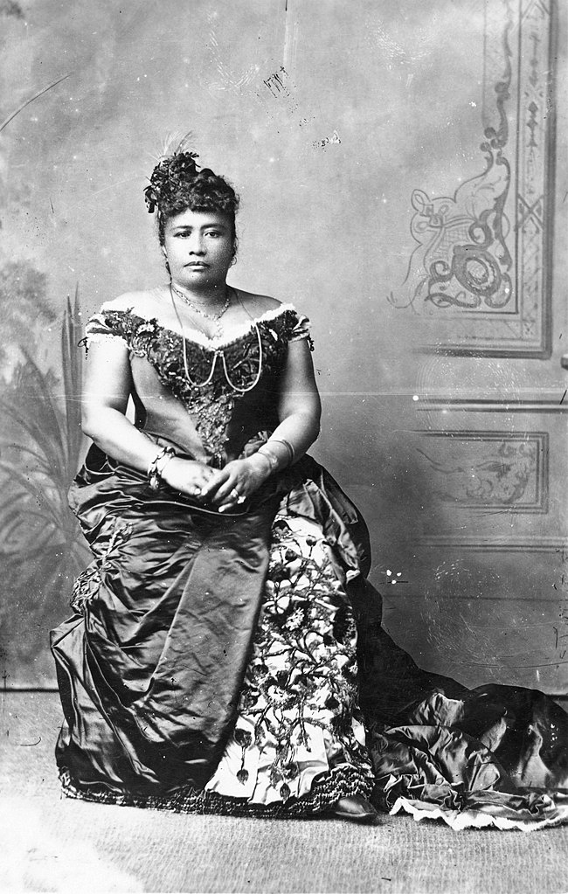
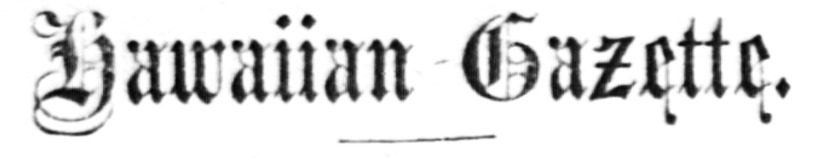
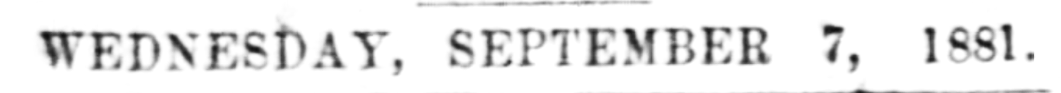
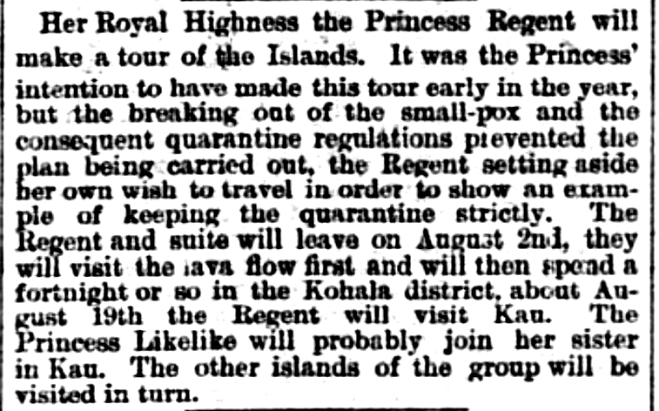
Leadership: Princess Liliʻuokalani’s 1881 quarantine limited the smallpox epidemic to Oʻahu.
Her own words on the next slide show her knowledge of public health measures and concern for her people.
Hawaiian Gazette, Volume XVII, Number 30, Page 2. July 27, 1881.
Notes:
Reflection | Knowing Hawaii’s tragic history and relationship with disease:
The number of deaths gets smaller and smaller with each passing epidemic
Thas a resilience if i ever saw one
this doesnʻt even scratch the surface of Hawaiʻis relationship with Smallpox; let alone with all the other epidemics that happened

Slide 12
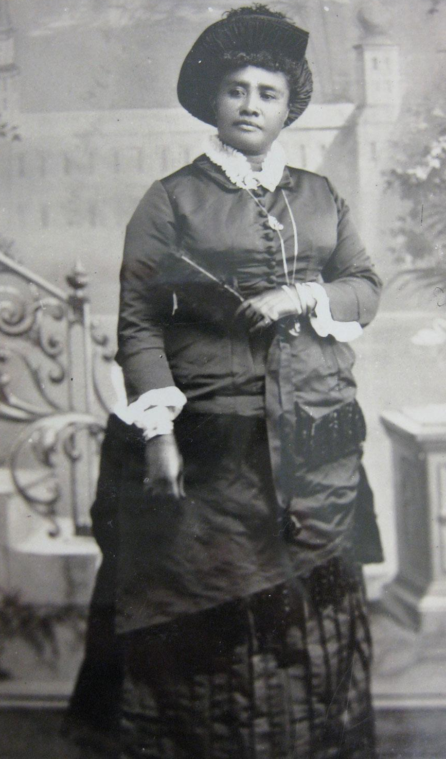
Queen Liliʻuokalani’s Autobiography, Chap. 12
King Kalakaua had been gone but a few weeks when the startling news was in circulation that the small-pox had broken out in the city...[O]ur past experience with the disease had shown us how fatal it might become to the Hawaiian people, and whatever the inconveniences it became necessary at all hazards to prevent its spread. Summoning the cabinet, I had all arrangements perfected to stay the progress of the epidemic. Communication between the different islands of the group was stopped. Vessels were absolutely prohibited from taking passengers. A strict quarantine of all persons infected or under suspicion was maintained; and so scrupulously and energetically were these regulations enforced, that when they were relaxed and quarantine raised, it was found that no case had been reported outside the place of its first appearance. But it was a serious thing to confine its ravages to the city of Honolulu, in which there were some eight hundred cases and about three hundred deaths.
(Liliʻuokanlani Trust)
Notes:
Reflection | Knowing Hawaii’s tragic history and relationship with disease:
The number of deaths gets smaller and smaller with each passing epidemic
Thas a resilience if i ever saw one
this doesnʻt even scratch the surface of Hawaiʻis relationship with Smallpox; let alone with all the other epidemics that happened

Slide 13

Ao holo`ōko`a:
nation/world/universe
Connecting Past, Present, Future
Nā honua mauli ola is a Hawaiian philosophy that health (mauli ola) is connected to three piko each person has: ʻī (spiritual, head), ʻō (family, belly button), and ʻā (next generation).
No one is an isolated individual. Mauli (self) develops within family (ʻiewe, ʻohana), community (kīpuka, kaiaulu), nation, and world (ao holoʻōkoʻa, honua) from childhood (keiki), to adulthood (mākua), to elder (kūpuna) status.
If I care for others during the COVID pandemic I care for myself, too. It is my kuleana, my responsibility.
Kīpuka, community
`iewe,family
‘ī
Mauli,
self
ʻOhana
‘ō
‘ā
Kaiaulu/community
Honua/global
Notes:
4.4 Kīpuka The third layer, entitled kīpuka, is a play on the word puka meaning ‘to say, come through.’94 Kīpuka addresses how things are said or expressed in Hawaiian as informed by, and therefore revealing, Hawaiian perspective. This then leads to another meaning in kīpuka ‘the opening in cloud formations’ symbolizing the portal to understanding Hawaiian perspective. (Pukui and Elbert, Hawaiian Dictionary, kīpuka.)

Slide 14
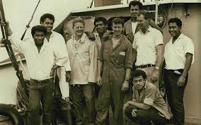
Watch the 21-minute video.
Think about the values, practices, decisions, and knowledge that enabled the teenagers to survive and create a healthy community.
1. What were the sources of the strengths that enabled their survival?
2. How did the boys share leadership and defuse conflict and anger?
3. How does their survival show that when we care for others, we also care for ourselves?
4. What can your leaders and you do to help your family, community, our state, and nation return to health during COVID-19?
What happened when six Tongan boys were shipwrecked for 15 months on a kapu island?

Slide 15
Glossary: Definitions of words used in this lesson
Community spread: spread of an illness, e.g., COVID-19 by community members vs. outsiders.
Contact tracing: to control transmission by identifying and quarantining persons who may have been in contact with someone infected with an infectious disease such as COVID-19.
Epidemic: any rise in cases beyond the baseline for that geographic area.
Immunity: the condition that permits either natural or acquired resistance to disease.
Isolation: to separate people infected with a contagious disease from those who are not.
Laʻau lapaʻau: herbal medicine, largely effective in Hawai‘i before introduced infectious diseases.
Leprosy: Hansen’s disease, an infectious but curable bacterial disease. First documented in 1835, 8,000 sufferers were isolated at Kalaupapa, Molokaʻi from 1866-1969 when isolation laws ended.
Measles: highly contagious, sometimes deadly viral disease able to be controlled by measles vaccine.
Minamina: 1. To regret, be sorry, deplore 2. To prize greatly especially something in danger of being lost.
Liliʻuokalani: Only reigning Hawaiian queen and last Hawaiian sovereign until 1898 U.S. Overthrow.
Pandemic: the worldwide spread of a new disease such as COVID-19.
Quarantine: to separate and restrict movement of people exposed to a contagious disease to see if they become sick. Quarantines (Italian quaranta giorni, 40 days) began in the 14th century to protect coastal cities.
Smallpox: human viral disease spread by coughing, sneezing, contact with sores, clothes, bedding.
Vaccination: treatment with a vaccine, typically containing an agent that has the critical features of a disease-causing microorganism to produce immunity against a disease.

Slide 16
History of Infectious Diseases in Hawaiʻi:
Caring for People Past, Present, and Future
First review slides, click on links to read articles, see videos.
Second, review Glossary for definitions of important terms.
Third, click on the “10 Question” link below to start the quiz for this module.
10 Question Quiz
Your goal is to score at least 90%, 9 correct out of 10.
If under 90%, review slides and readings and take the quiz up to two more times.
Some questions may be different in each quiz.
Submit your highest score.
5. Mahalo nui loa for your time and attention!

Slide 17
To Teachers: This module addresses Social Studies, NGSS, Common Core, Health, Nā Hopena Aʻo
Inquiry Standard SS.9-12.1.2 Critique compelling questions that reflect an enduring issue in the field
Next Generation Science Standards: Cross-cutting concepts
2. Cause and Effect: Mechanism and Prediction: Events have causes, sometimes simple, sometimes multifaceted.
4. Systems and system models. Defining the system under study provides tools for understanding and testing ideas.
3. Common Core CCSS.ELA-LITERACY.RH.11-12.7
Integrate and evaluate multiple sources of information presented in diverse formats and media (e.g., visually, quantitatively, as well as in words) in order to address a question or solve a problem
4, Health Education Standards
Comprehending Concepts related to health promotion and disease prevention to enhance health.
Analyzing Influences of family, peers, culture, media, technology, and other factors on health behavior.
5. Nā Hopena A‘o
To develop a sense of Wellbeing | To develop a sense of Belonging | To develop a sense of Aloha | To develop a sense of Hawai`i.
6. Nā Honua Mauli Ola:
Promote personal growth and development to strengthen cultural identity, academic knowledge and skills, pono decision making, and the ability to contribute to one’s self, family, local and global communities.
7. UN Sustainable Development Goal #3 Good Health and Well-being
Ensure healthy lives and promote well-being for all at all ages

Slide 18
COVID-19 Information and Resources
Centers for Disease Control and Prevention
  What to Do If You Are Sick If you have a fever, cough or other symptoms.
  If you have an emergency warning sign, get emergency medical care immediately.
Hawaiʻi State Department of Health: Disease outbreak control division
Get the Facts about COVID-19
Hawai‘i COVID-19 Data
Office of Language Access: COVID-19 Multilingual Resources
School Guidance
3. Hawaiʻi State Department of Education
Board of Education July 15 Resolution encouraging vaccination
RETURN TO LEARN: SCHOOL REOPENING PLAN
4. One Oahu organization
Reopening Strategy
Find a COVID-19 vaccination provider near you
5. The Washington Post
Community spread: casual American life is fueling the coronavirus surge.
Daily updates by state: cases and deaths from coronavirus in the U.S.
6. Johns Hopkins University
Coronavirus Resource Center

Slide 19
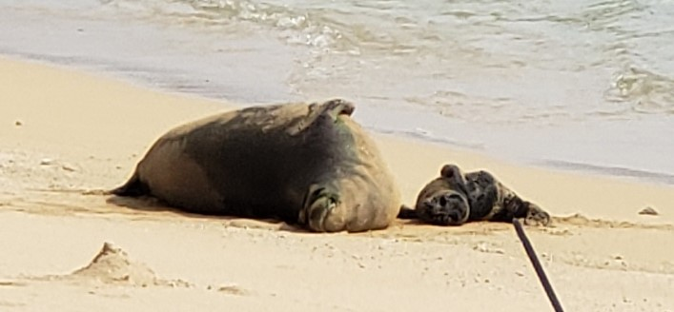
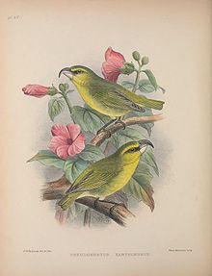
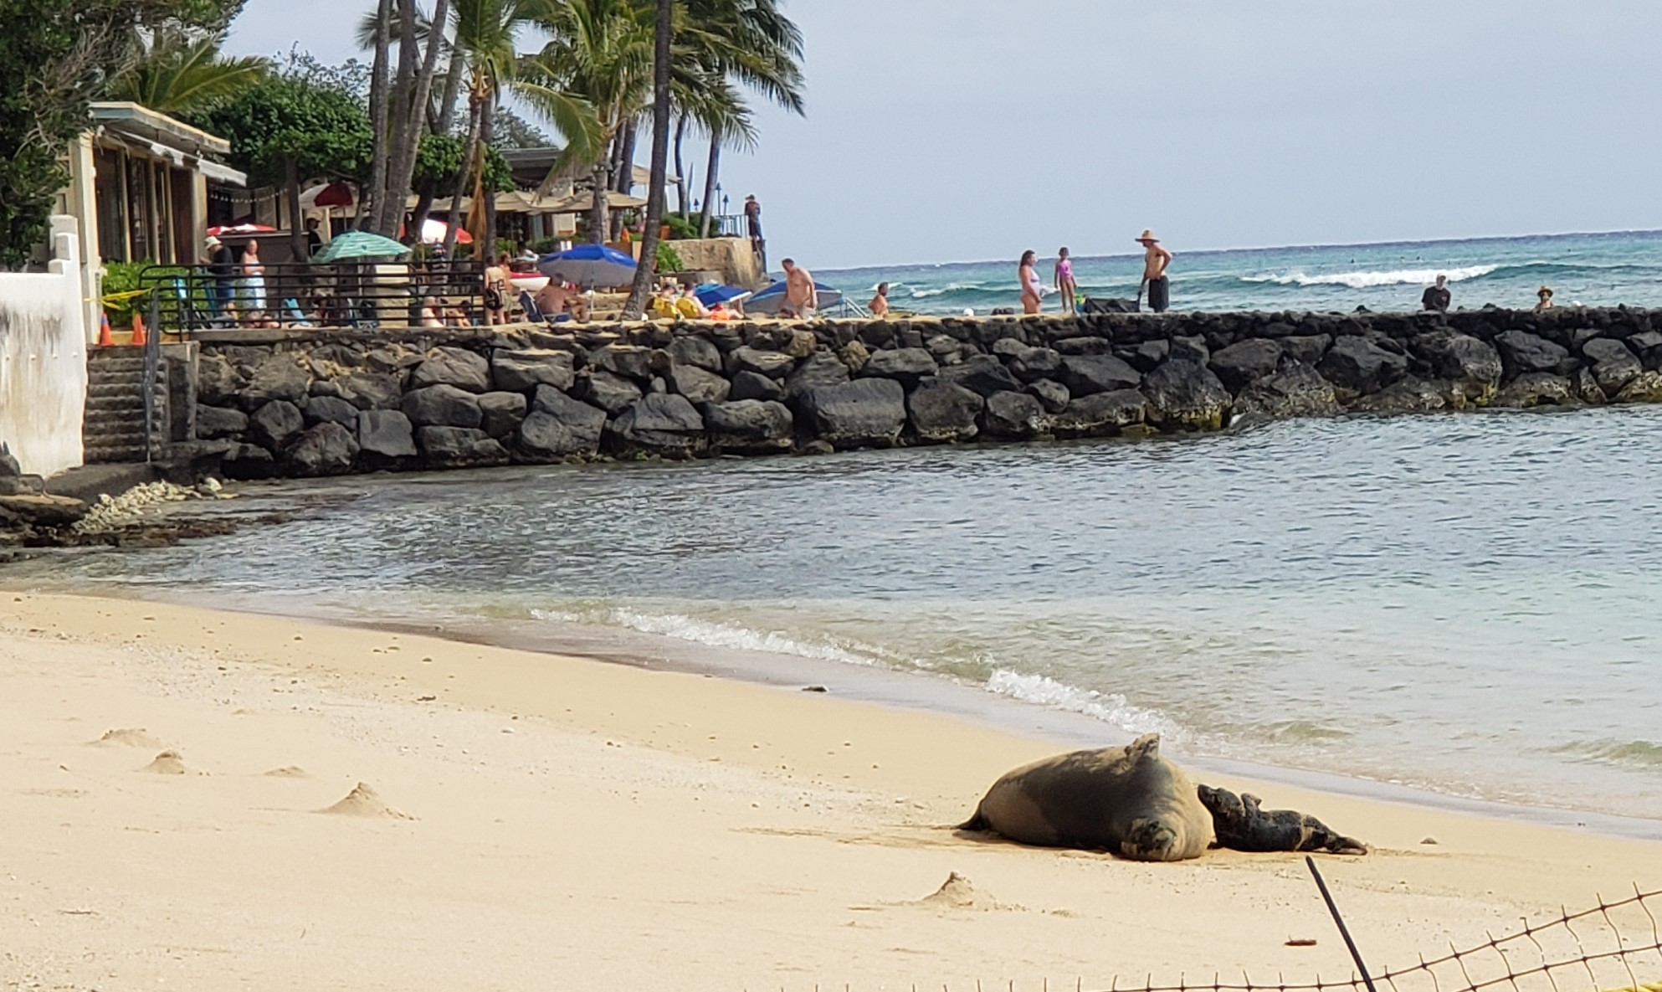
Final thoughts:
Itʻs not only people who suffer from introduced infectious diseases. Monk seals are vaccinated against distemper virus introduced by dogs. Federal laws protect monk seals from humans and their pets. Hawai‘i’s native birds are threatened by introduced bird pox and bird malaria spread by introduced mosquitoes. Let’s work together to protect what is precious and in danger of being lost.
Endangered monk seal and pup, Waikiki, May 2021
(Photos: P. Chinn)
Kiwikiu, Maui Parrotbill, critically endangered.
Illustration by Frederick William
Frohawk, Wikipedia.

