Slide 1
Instructions on how to access the curriculum:
Press the Play button (filled arrow) to start the slideshow. Each slide will be displayed for 5 seconds.
The slideshow can be paused at any given point by hitting the Pause button (parallel lines). Hitting Play again resumes the slideshow.
Use the < > arrows to move between slides at any given point of time
Move to a specific slide using the drop down menu. Select the slide you want from the list and the slide will appear.
There are options to use an on-screen laser and/or switch to fullscreen mode.

Slide 2
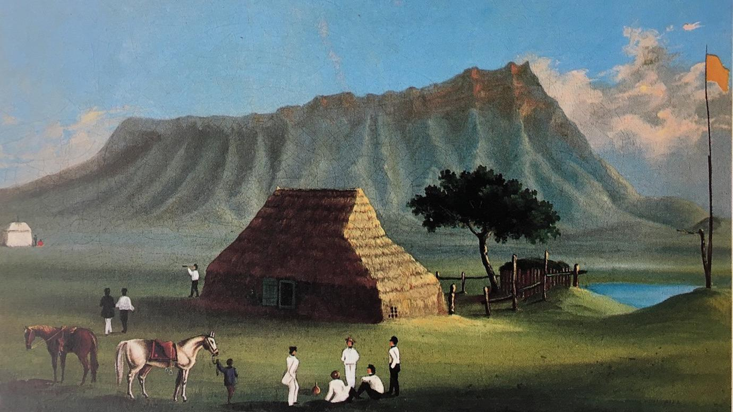
MODULE I COVID-19 CURRICULUM History of Infectious Diseases in Hawaiʻi: Caring for People Past, Present, and Future
View of Smallpox Hospital, c. 1853-59 (Wikipedia Commons)
Riley Kauʻilani Wells, Kyle Kolomona Nakatsuka, Pauline W. U. Chinn
University of Hawaiʻi at Mānoa
Pacific Alliance Against COVID-19 (PAAC)
NSF Teacher Leadership Project

Slide 3
WHY Study Hawaiʻi’s History of Introduced Infectious Diseases?
TO ADDRESS THE ESSENTIAL QUESTION:
What can we learn from the values and actions of Hawaiʻi’s aliʻi and Polynesian culture to guide us in the current COVID-19 pandemic?
In this module you will:
Learn terms and concepts related to Hawaiʻi’s past and present health practices.
Learn why 90% of the Hawaiian population, isolated for centuries, died from newly introduced infectious diseases between 1788-1900.
Learn about introduced diseases from 1788 to the current COVID-19 pandemic.
Study a 20th C. survival story involving Polynesian cultural values and practices.
Consider how Polynesian values and actions appy to the COVID-19 pandemic.
Take a 10-question quiz to check your learning. You may retake it for a higher score.

Slide 4
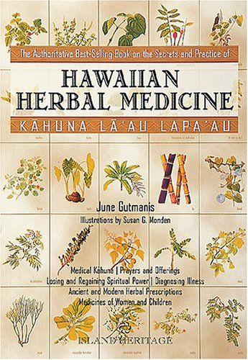
Lawe li'ili'i ka make a ka Hawai'i, lawe nui ka make a ka haole. Death by Hawaiians takes a few at a time; death by foreigners takes many. (No.1960, Pukui)
Overall, Hawaiians enjoyed good health before western contact. People were active, food was organic and mostly plant-based, strict rules kept water clean, isolation kept out diseases (Abbott, 1992).
Well-trained kahuna laʻau lapaʻau, herbal doctors, prepared 12 commonly used medicinal plants, 8 brought by Polynesian voyagers.
Diagnosticians, kahuna hāhā, memorized the characteristics and history of diseases from the place and time of first appearance to the present. We use this process, contact tracing, to identify persons who may have been in contact with someone infected with COVID-19.
Foreign ships brought new diseases: smallpox, measles, flu. With no prior exposure and no immunity, many people died. These observations led to a new ʻōlelo noʻeau, “Lawe li'ili'i ka make a ka Hawai'i, lawe nui ka make a ka haole. Death by Hawaiians (diseases) takes a few at a time; death by foreigners (diseases) takes many.”

Slide 5
Hawaiʻi’s historical relationship with introduced disease
Centuries of isolation left Native Hawaiians with no immunity to introduced diseases.
Laʻau lapaʻau, traditional herbal medicine, worked for familiar illnesses but was ineffective against introduced diseases.
Learn more about cholera, measles, smallpox, leprosy, Spanish flu, whooping cough, bubonic plague, scarlet fever.
Whooping cough epidemic
Kunu kalea kills thousands.
Bubonic plague
61 deaths.
Chinatown destroyed.
Spanish Flu 1918-20 kills 2,300
Hawaiian Medicine Board
Licensure for Lāʻau Lapaʻau practitioners.
Maʻi okuʻu (cholera)
Kills 15,000
California Gold Miners
Diarrhea, flu, measles kill >10,000.
Father Damien
Serves leprosy patients at Kalawao.
Moikeha
Hawai‘i relatively free of disease.
Smallpox epidemic
Maʻi puʻuliʻiliʻi kills 7,000.
Hawaiian Medicine Board is abolished
Lāʻau Lapaʻau no longer licensed.
1778
1819
1840
1850
1870
1882
1911
1959
1400
1804
1832
1845
1853
1874
1899
1919
1965
2019
COVID-19
Hawaii is proclaimed a state by U.S. congress
Kamehameha suffers stroke
Kapu system overthrown.
First Board
of Health
Appointed by Kamehameha III.
4th smallpox epidemic
From China; kills 282.
Yellow fever
Fumigation and sanitation to control mosquitoes.
Captain Cooke
Gonorrhea (maʻi hilo, paia), syphilis (kaokao), tuberculosis (akepau)
First case of leprosy
Maʻi Pākē; Maui.
Scarlet Fever epidemic
Piwa ʻulaʻula; Maui.
“Hawaiian Health Timeline and Events.” Kekuni Blaisdell, 1998. Updated by Papa Ola Lokahi, 2016
.

Slide 6
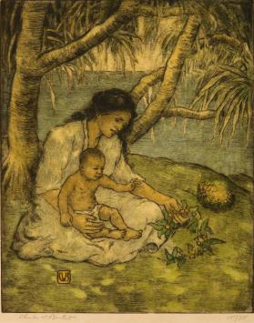
Minamina ‘ia ka ‘ike Hawai’i | Hawaiian language, health, leadership
mina.mina
1. nvt. To regret, be sorry, deplore; to grieve for something that is lost; regret, sorrow.
ʻAʻole minamina ʻo lākou i ke ola. They do not set much value on human life.
2. To prize greatly, value
greatly, especially of
something in danger of
being lost; to value, place
great value on.
He mea minamina ʻia ke
keiki. A child is to be prized.
Source: Ulukau: Nā Puke Wehewehe
ʻŌlelo Hawaiʻi
Hawaiian Mother and Child,
ca. 1920. C. W. Bartlett
(Honolulu Museum of Art)
We expect our leaders to make decisions based on best information to care for the people and the land, but it is our kuleana, responsibility, too.
Read “Shutting Down Hawai‘i: A Historical Perspective on Epidemics in the Islands” Herman, D. (March 25, 2020)/ here.
Read Hawaiian language newspaper articles on epidemics here.
We all must take informed actions to avoid COVID-19 regrets, minamina.
Community spread, not travel, causes most COVID-19 cases in Hawaiʻi.
Updated daily: COVID-19 Dashboard with race, age, gender, county, source of contagion.
Current information: What You Should Know, Get the facts on COVID-19.

Slide 7
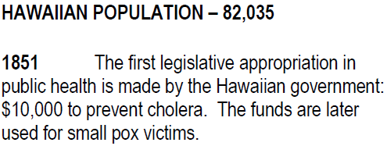
The Kingdom prioritized public health by monitoring (kilo) and acting to prevent disease.
The Kingdom passed a Quarantine Law in 1839, the US finally did in 1878.
Hawaiian Population | 49,000
Queen Liliʻuokalani yields under protest.
1894 Hawaiian population | 40,000
Foreign population | 50,000
Hawaiian Population | 28,800
Hawaiian Population | 82,035
Mina.mina
2. To prize greatly, value greatly, especially of something in danger of being lost; to value, place great value on.
The Aliʻi founded: Queen’s Hospital, Kapiʻolani Hospital, Lunalilo Home, Queen Liliʻuokalani Trust.
“Hawaiian Health Timeline and Events.”
Dr. Kekuni Blaisdell, 1998. Updated by Papa Ola Lokahi, 2016
Notes:
Reflection | Knowing Hawaii’s tragic history and relationship with disease:
The number of deaths gets smaller and smaller with each passing epidemic
Thas a resilience if i ever saw one
this doesnʻt even scratch the surface of Hawaiʻis relationship with Smallpox; let alone with all the other epidemics that happened

Slide 8
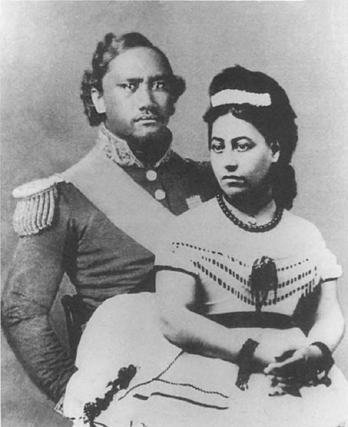
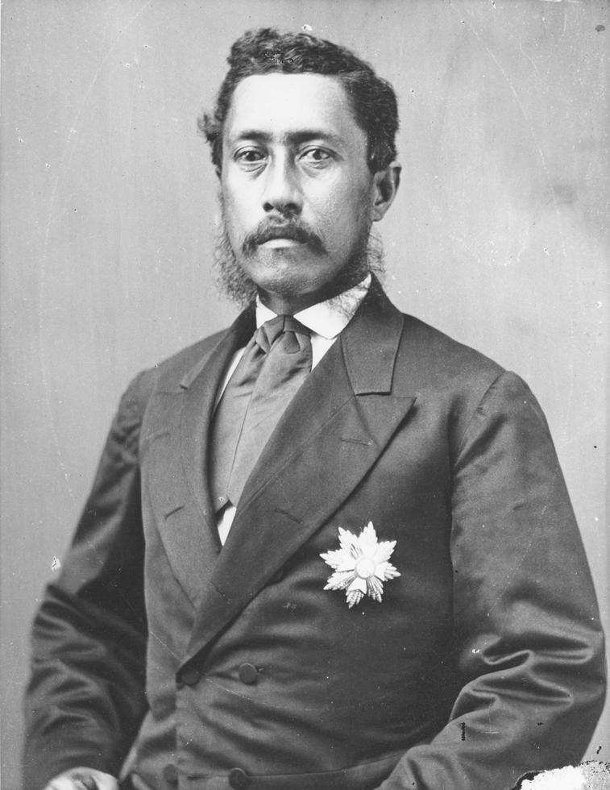
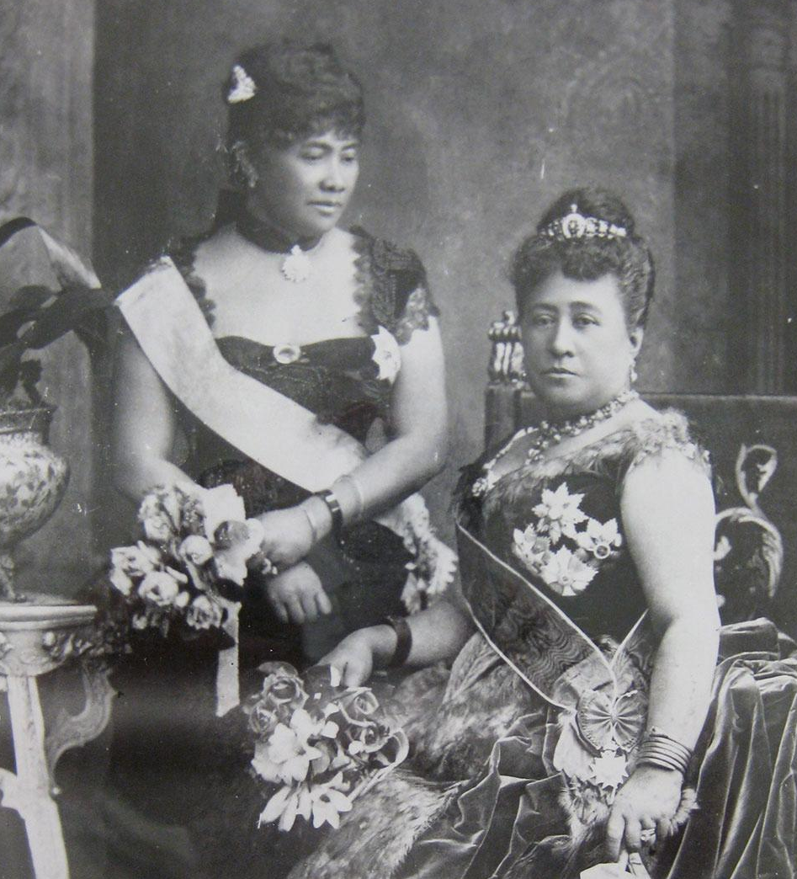
Visionary Leadership: Actions of Aliʻi to care for keiki to kūpuna into the future
Queen’s Hospital was founded in 1859 by Queen Emma and King Kamehameha IV to address the diseases that were decimating the Hawaiian population. There was no money in the treasury, so they personally solicited funds and donated their own money to raise $13,530 to build the hospital.
Lunalilo Home was established by the will of William Charles Lunalilo, who died a bachelor in 1874. King Lunalilo was the first large landholding aliʻi to create a charitable trust for the benefit of his people. The trust built a home for the poor, destitute, and infirm people of Hawaiian blood, with preference given to older people.
Wikimedia Commons
Wikimedia Commons
Lydia Lili‘u Loloku Wewehi Kamaka‘eha, sister of King Kalākaua and hanai sister of Princess Pauahi, was a scholar, lover of books, musician, and composer. When 10, young Lili‘u witnessed grief and suffering during the 1848 measles epidemic that killed over 10,000. She established the Queen Lili‘uokalani Trust in 1909 with ancestral lands from her mother, Keohokālole. The Trust is dedicated to the wellbeing of the least fortunate Hawaiian keiki. Orphan and destitute Hawaiian children are the primary beneficiaries of her estate.
Concerned about the welfare of mothers and babies, Queen Kapiʻolani, Consort to King Kalākaua founded the Kapiʻolani Maternity Home in 1890 with $8,000 raised by holding bazaars, luau and other benefits. In 1909, Albert and Emma Kauikeolani Wilcox donated funds for Kauikeolani Children’s Hospital as two out of seven babies died in their first year. In 1978, Kapiʻolani and Kauikeolani Children’s Hospitals became Kapiʻolani Medical Center for Women & Children.
Queen Kapiʻolani (R), Crown Princess Liliʻuokalani (L) at 1874 Golden Jubilee. (Images of Old Hawaii)

Slide 9
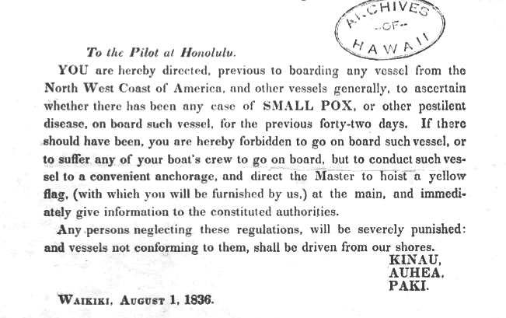
Public health during the Kingdom: Hoʻomalu i ka wa mā mua, a hoʻomalu nō i ka wā ma hope, Protect the past and protect the future
Credits: Hawaii Judiciary Archives / Punawaiola
“Hawaiian Health Timeline and Events.”Dr. Kekuni Blaisdell, 1998. Updated by Papa Ola Lokahi, 2016.
Notes:
Look up “Quarantine law” and “vital statistics act”
1822
First water filtration plant on Oahu is established (Hope & Hope, 2003).
1850
First cases of cholera epidemic diagnosed in San Francisco were Kanakas ​(Hope & Hope, 2003)
1862
In order to address sanitation issues and address the depopulation of Native Hawaiians, the Sanitary Commission was created. (Hope & Hope, 2003).
1895
Cholera epidemic hits the islands, killing 64. Originating from China and Japan and arriving aboard the “Belgic,” the disease is confined to Honolulu (Mills & Ryder, 1896)
1898
The Food Commissioner Department is initiated to handle sanitation issues in the food industry (Hope & Hope, 2003).
1911
Another cholera outbreak in Hawaii. Out of 27 cases, 21 were fatal. (Hope & Hope, 2003) // 1911 Prohibition of Poi (Kim, n.d.)
Reflection | Knowing Hawaii’s tragic history and relationship with disease:
The number of deaths gets smaller and smaller with each passing epidemic
Thas a resilience if i ever saw one
this doesnʻt even scratch the surface of Hawaiʻis relationship with Smallpox; let alone with all the other epidemics that happened

Slide 10
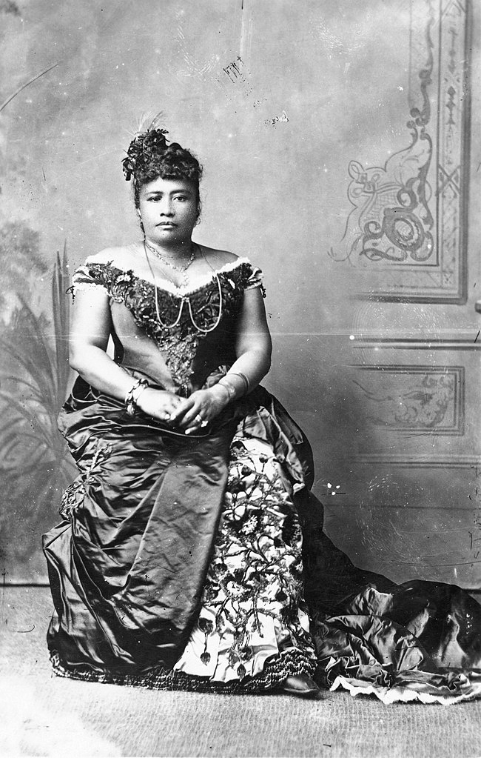
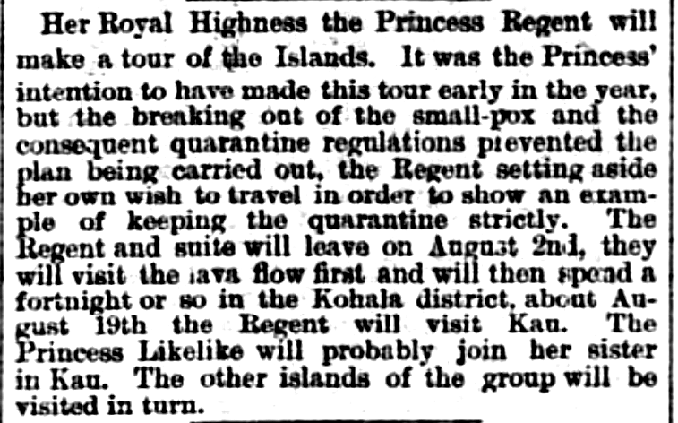
Leadership: Princess Liliʻuokalani’s 1881 quarantine limited the smallpox epidemic to Oʻahu.
She delayed traveling to set an example. Later, she visited Kalaupapa, where victims of leprosy were isolated.
Hawaiian Gazette, Volume XVII, Number 30, Page 2. July 27, 1881.
Notes:
Reflection | Knowing Hawaii’s tragic history and relationship with disease:
The number of deaths gets smaller and smaller with each passing epidemic
Thas a resilience if i ever saw one
this doesnʻt even scratch the surface of Hawaiʻis relationship with Smallpox; let alone with all the other epidemics that happened

Slide 11
Ao holo`ōko`a:
nation/world/universe
Connecting Past, Present, Future
Nā honua mauli ola is a Hawaiian philosophy that health (mauli ola) is connected to three piko each person has: ʻī (spiritual, head), ʻō (family, belly button), and ʻā (next generation).
No one is an isolated individual. Mauli (self) develops within family (ʻiewe, ʻohana), community (kīpuka, kaiaulu), nation, and world (ao holoʻōkoʻa, honua) from childhood (keiki), to adulthood (mākua), to elder (kūpuna) status.
If I care for others during the COVID pandemic I care for myself, too. It is my kuleana, my responsibility.
Kīpuka, community
`iewe,family
‘ī
Mauli,
self
ʻOhana
‘ō
‘ā
Kaiaulu/community
Honua/global
Notes:
4.4 Kīpuka The third layer, entitled kīpuka, is a play on the word puka meaning ‘to say, come through.’94 Kīpuka addresses how things are said or expressed in Hawaiian as informed by, and therefore revealing, Hawaiian perspective. This then leads to another meaning in kīpuka ‘the opening in cloud formations’ symbolizing the portal to understanding Hawaiian perspective. (Pukui and Elbert, Hawaiian Dictionary, kīpuka.)

Slide 12
Watch the 21-minute video. Think about the values, practices, decisions, and knowledge that enabled the teenagers to survive and create a healthy community. 1. What were the sources of the strengths that enabled their survival? 2. How did the boys share leadership and defuse conflict and anger? 3. How does their survival show that when we care for others, we also care for ourselves? 4. What can your leaders and you do to help your family, community, our state, and nation return to health during COVID-19?
What happened when six Tongan boys were shipwrecked for 15 months on a kapu island?

Slide 13
Glossary: Definitions of words used in this lesson
Community spread: people infected with virus causing COVID-19 locally, including some who are not sure how or where they became infected.
Contact tracing: to control transmission by identifying and quarantining persons who may have been in contact with someone infected with COVID-19.
Epidemic: any rise in cases beyond the baseline for that geographic area.
Immunity: the condition that permits either natural or acquired resistance to disease.
Isolation: to separate people infected with a contagious disease such as COVID-19 from those who are not.
Laʻau lapaʻau: traditional herbal medicine, largely effective in Hawaiʻi prior to introduced infectious diseases.
Leprosy: Hansen’s disease, an infectious but curable bacterial disease. First documented in 1835, 8,000 sufferers were isolated at Kalaupapa, Molokaʻi from 1866-1969 when isolation laws ended.
Measles: highly contagious, sometimes deadly viral disease able to be controlled by measles vaccine.
Minamina: 1. To regret, be sorry, deplore 2. To prize greatly especially of something in danger of being lost.
Liliʻuokalani: Only reigning Hawaiian queen and last Hawaiian sovereign until 1898 U.S. Overthrow.
Pandemic: the worldwide spread of a new disease such as COVID-19.
Quarantine: to separate and restrict movement of people exposed to a contagious disease to see if they become sick. Quarantines (from the Italian quaranta giorni, 40 days) began in the 14th century to protect coastal cities.
Smallpox: viral disease only in people spread by coughing, sneezing, contact with sores, clothes, bedding.
Vaccination: treatment with a vaccine, typically containing an agent that resembles all or part of a disease-causing microorganism to produce immunity against a disease.

Slide 14
History of Infectious Diseases in Hawaiʻi: Caring for People Past, Present, and Future
First review slides, click on links to read articles, see videos.
Second, review Glossary for definitions of important terms.
Third, click on the “10 Question” link below to start the quiz for this module.
10 Question Quiz
Your goal is to score at least 90%, 9 correct out of 10.
If under 90%, review slides and readings and take the quiz up to two more times.
Some questions may be different in each quiz.
Submit your highest score.
5. Mahalo nui loa for your time and attention!

Slide 15
To Teachers: This module addresses Social Studies, NGSS, Common Core, Health, Nā Hopena Aʻo
Inquiry Standard SS.9-12.1.2 Critique compelling questions that reflect an enduring issue in the field
Next Generation Science Standards: Cross-cutting concepts
2. Cause and Effect: Mechanism and Prediction: Events have causes, sometimes simple, sometimes multifaceted.
4. Systems and system models. Defining the system under study provides tools for understanding and testing ideas.
3. Common Core CCSS.ELA-LITERACY.RH.11-12.7
Integrate and evaluate multiple sources of information presented in diverse formats and media (e.g., visually, quantitatively, as well as in words) in order to address a question or solve a problem
4, Health Education Standards
Comprehending Concepts related to health promotion and disease prevention to enhance health.
Analyzing Influences of family,peers, culture, media, technology, and other factors on health behavior.
5. Nā Hopena A‘o
To develop a sense of Wellbeing | To develop a sense of Belonging | To develop a sense of Aloha | To develop a sense of Hawai`I
6. Nā Honua Mauli Ola:
Promote personal growth and development to strengthen cultural identity, academic knowledge and skills, pono decision making, and the ability to contribute to one’s self, family, local and global communities.
7. UN Sustainable Development Goal #3 Good Health and Well-being
Ensure healthy lives and promote well-being for all at all ages

Slide 16
Reliable COVID-19 Information and Resources
Centers for Disease Control and Prevention
What to Do If You Are Sick If you have a fever, cough or other symptoms, you might have COVID-19. If you think you may have been exposed to COVID-19, contact your healthcare provider.
If you have an emergency warning sign (including trouble breathing), get emergency medical care immediately.
State of Hawaiʻi - Department of health: Disease outbreak control division: COVID-19
Get the Facts about COVID-19
Hawaiʻi Reproductive Rate Rt
Hawaiʻi State Department of Education
RETURN TO LEARN: SCHOOL REOPENING PLAN (Nov. 13, 2020)
The Washington Post
Community spread: At dinner parties and game nights, casual American life is fueling the coronavirus surge.
Daily updates for how many people have died from coronavirus in the U.S.
Johns Hopkins University
Coronavirus Resource Center
One Oahu organization
Protect Yourself. Each Other. Hawai‘i.

